Slide 1
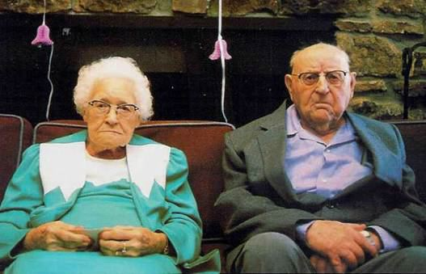
Differences:
Talkers, Doers, Thinkers, Planners
www.kevinhinckley.com

Slide 2
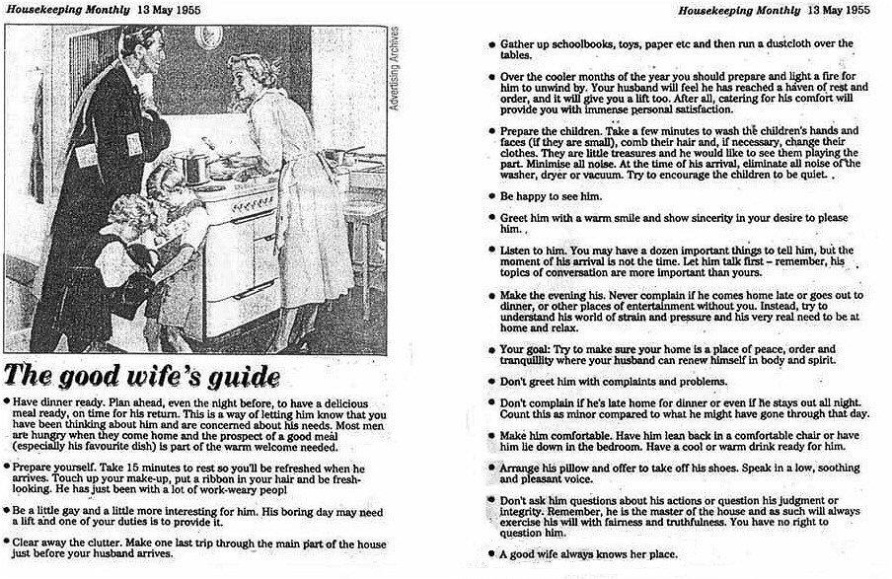

Slide 3

President Spencer W. Kimball
"We are concerned over the mounting number of divorces not only in our society, but in the Church.
We are just as concerned with those whose families and marriages seem to be held together in 'quiet desperation.‘
The Privilege of Holding the Priesthood," in Priesthood (Salt Lake City: Deseret Book Company, 1981), 4-5.

Slide 4

Success in Marriage
One research study suggests the #1 reason for marriage difficulty and divorce:
Conflict?
Communication?
Finances?
Number #1 reason?
Disillusionment.
I expected A and got B.
Psychology Today. Aviva Patz is the executive editor of
Psychology Today.
April 23, 2000

Slide 5

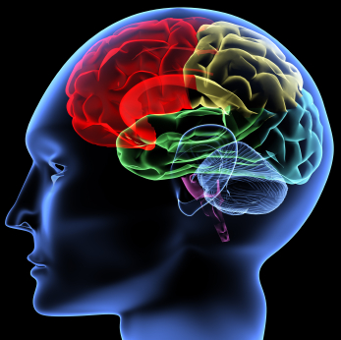
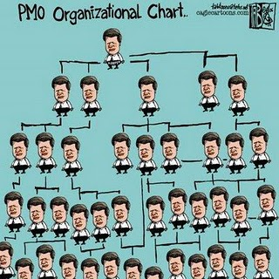

Men’s Brains Vs Women’s Brains
Husband Guy
Father Guy
Worker Guy
Church Guy
Handy Man Guy
Intimacy Guy
Work Out Guy
Zombie Guy

Slide 6
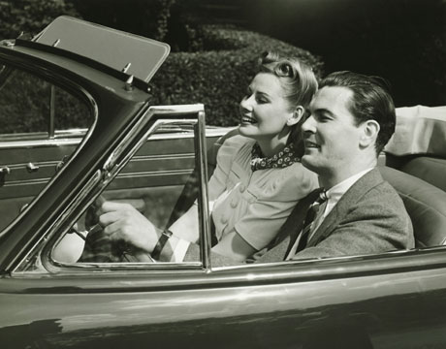
Men and Women
Roger and Elaine have been dating for 6 months. It looks like its getting serious. One night, as drive home from the movies, Elaine casually comments:
"Roger, do you realize that, as of tonight, we've been seeing each other for exactly six months?"
Elaine thinks: Gee, I wonder if it bothers him that I said that. Maybe he's feeling obligated
Elaine thinks: Are we heading toward marriage? Toward children? Toward a lifetime together? Am I ready for that level of commitment?
He's upset. I can see it on his face. Maybe I'm reading this completely wrong. Maybe he wants more from our relationship but can’t say it. He's afraid of being rejected.
He's angry. And I don't blame him. I'd be angry, too. I feel so guilty, putting him through this,
Maybe I'm just too idealistic, waiting for a knight to come riding up on his white horse…A person who is in pain because of my self-centered, school girl romantic fantasy.
(Roger Is quiet)
Roger thinks: “wow. Six months”
Roger thinks: Hmmm. 6 months was right after I had the car at the dealer. That means...lemme check the odometer. Whoa! I am way overdue for an oil change here.
And I'm gonna have them look at the transmission again. I don't care what those morons say, it's still not shifting right.
They'll probably say it's only a 90-day warranty. Scumbags!
Warranty? They want a warranty? I'll give them a warranty. I'll tear it up right in their face!

Slide 7
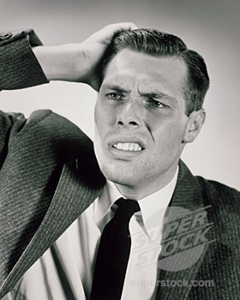
Elaine finally says: Roger?
Please don't torture yourself like this. Maybe I should never have...
"I'm such a fool. I mean, I know there's no knight. I really know that. It's silly. There's no knight, and there's no horse
"You think I'm a fool, don't you?“
"It's just that... it's that I... I need some time,"
Long Pause….
“Ok, then. Thank you, Roger,“
That night, Elaine lies on her bed, a conflicted, tortured soul, and weeps until dawn.
The next day Elaine will call three friends, sort endlessly through her last conversation with Roger and try desperately to understand where it all suddenly went wrong.
Yes?
What?
"There's no horse?"
No, of course not!
“Uh, Ok…“
Roger is thinking: Horse? where did the horse come from?
Uh, you’re welcome!
Roger gets back to his place, turns on the TV and starts watching an old war movie.
A tiny voice in the far recesses of his mind tells him that something major was going on back in the car, but he has no idea what it was.
The next day Roger will run into a mutual friend and casually ask: “By the way, do you know if Elaine ever had a horse?”

Slide 8


Another Difference
Criticism

Slide 9

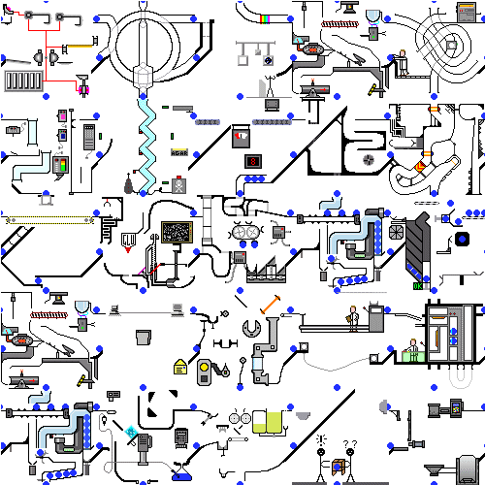
Your Job- Go From A to B
Men
A
B
Women
A
B

Slide 10
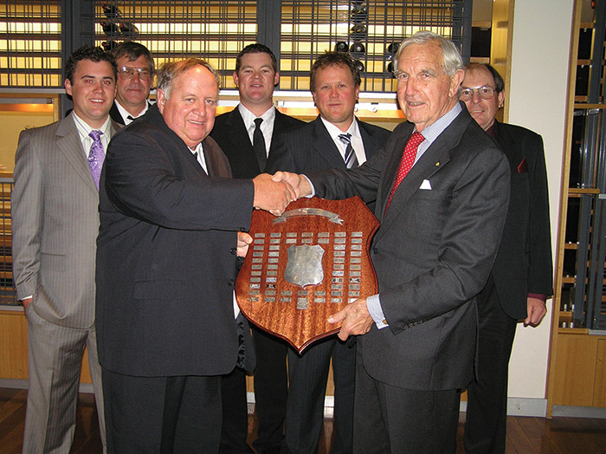
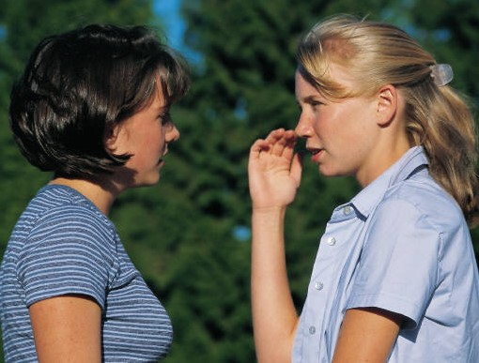
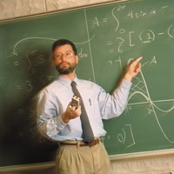
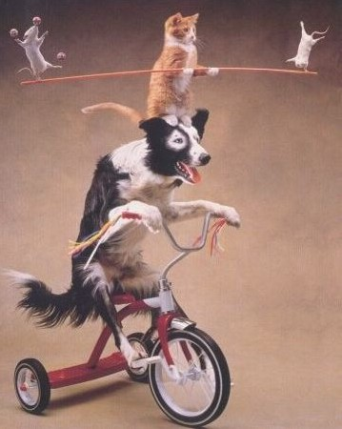
Four Basic Personality Styles
Talkers
Socially Oriented
Spontaneous
Dislikes too many rules
Avoids routines (too boring!)
Emotional/feeling based
Thinkers
Analyzers
Thoughtful and Careful
Prefers Structure
Questioning, wants answers
Rationally Based
Doers
Goal oriented
Impulsive
Impatient
More leader than follower
Focused on results
Planners
Process Oriented
Organized
Follows set routine
Avoids the spotlight

Slide 11

How might we ‘resist’ the Spirit?
It doesn’t make any rational sense to feel the spirit ‘constantly’. We are responsible to think things through, then have our decisions confirmed!
I’ve got one friend who says she hears a voice, and another feels a burning. How can I feel the spirit if I don’t know what to feel?
Talkers
Thinkers
Doers
Planners
Following the spirit sort of feels like giving up your free agency—and I don’t like feeling out of control.
To be honest, I kind of was planning on doing something else. How do I really know I’m feeling the spirit?
President Benson:
Seek the Spirit in all you do. Keep it with you continually."

Slide 12
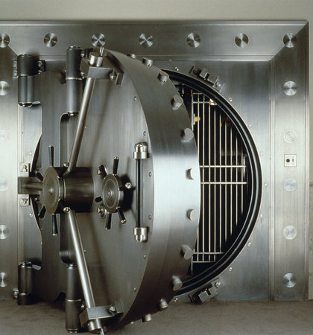
Beliefs Emotions Actions
=
Rational
Irrational
Basic Truths Logic | Phobias Superstitions Bad Habits
Internal Belief System Habits | ??
Conscious
Thoughts
+
Unconscious
Thoughts
Kevinhinckleylpc.com

Slide 13
Beliefs Emotions Actions
Irrational Thoughts | What I Feel | What I Do | Consequences
I’m broken
Worthless
Isolate
More Depressed
Reality (Truth) | What I Feel | What I Do | Consequences
The Atonement heals what I can’t.
Gratitude, Hope
Trust Him, not me…
Feel more joy
Kevinhinckleylpc.com

