Slide 1
Back from the brink Trust in Marriage

Slide 2
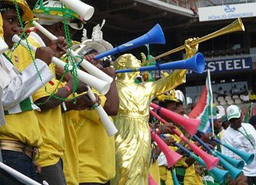
World Cup- Nigeria!

Slide 3
Life According to Dilbert

Slide 4
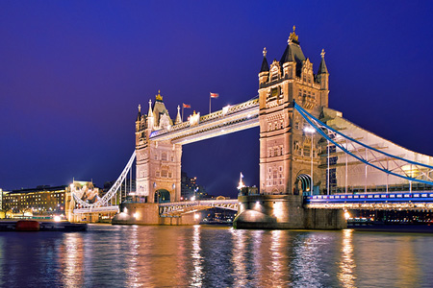
Molly

Slide 5
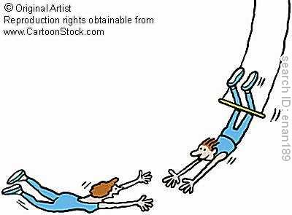
The Great Challenge
Marriage And Trust

Slide 6
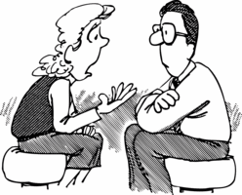
Client Question
How Do I Love him and Trust him at the same time?

Slide 7
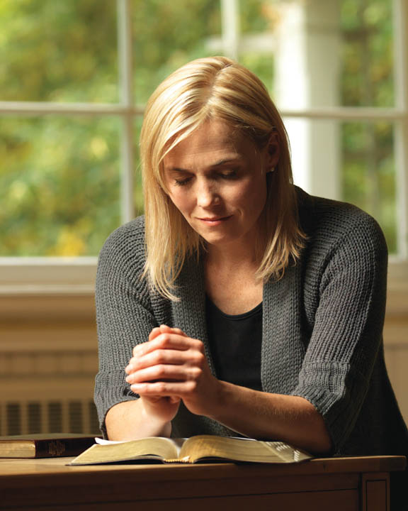
Hinckley’s Rule of Healing!
You cannot begin to really trust, until you begin to forgive….
And in order to forgive, you must first feel the joy of forgiveness

Slide 8
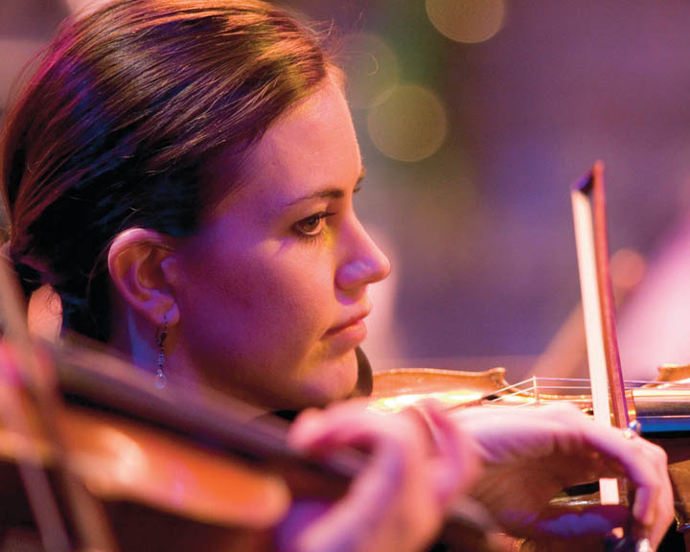
Cathy

Slide 9
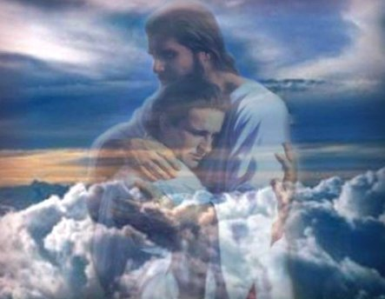
Very Important
In Hebrew, the word for Repent (Nach’am)
Also means “Comfort”

Slide 10
Alma 41 Law of Restoration
7 These are they that are redeemed of the Lord; yea, these are they that are taken out, that are delivered from that endless night of darkness; and thus they stand or fall; for behold, they are their own judges,
13 …the meaning of the word restoration is to bring back again …good for that which is good; righteous for that which is righteous; just for that which is just; merciful for that which is merciful.
14 Therefore, ye spouse, see that you are merciful unto your brethren; deal justly, judge righteously, and do good continually;
and if ye do all these things then shall ye receive your reward;
yea, ye shall have mercy restored unto you again; ye shall have justice restored unto you again; ye shall have a righteous judgment restored unto you again; and ye shall have good rewarded unto you again.

Slide 11
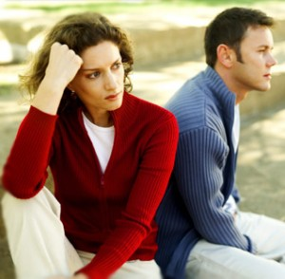
Brace Yourself…
Elder Marion D. Hanks
"The withholding of love [holding a grudge] is the negation of the spirit of Christ, the proof that we never knew him, that for us he lived in vain.
It means that he suggested nothing in all our thoughts, that he inspired nothing in all our lives,
that we were not once near enough to him to be seized with the spell of his compassion for the world."
FORGIVENESS: THE ULTIMATE FORM OF LOVE

Slide 12
Some Reasons We Don’t Extend Forgiveness
That would let them off the hook (Not Fair!)
That would diminish what happened to me
It would give them permission to do it again

Slide 13
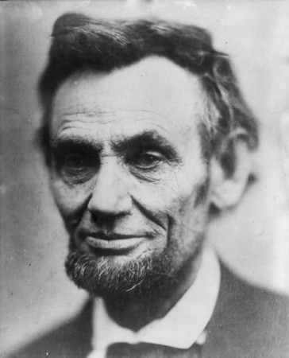
Lincoln said in those dark, dark days of his First Inaugural,
“Though passion may have strained, it must not break our bonds of affection.
The mystic chords of memory will yet swell … when again touched,
as surely they will be,
by the better angels of our nature.”

Slide 14
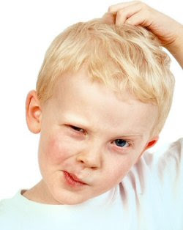
Question
Can I forgive and not trust?

Slide 15
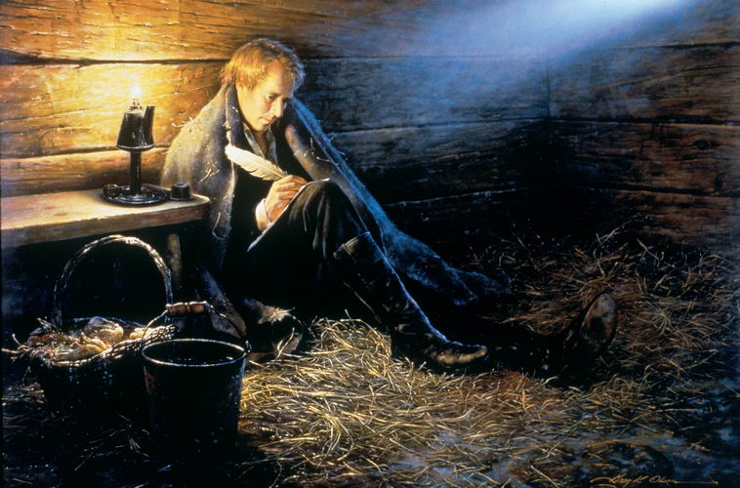
Joseph Smith, in Liberty Jail
41 No power or influence can or ought to be maintained by virtue of the priesthood, only by persuasion, by long-suffering, by gentleness and meekness, and by love unfeigned;
42 By kindness, and pure knowledge, which shall greatly enlarge the soul without hypocrisy, and without guile—
43 Reproving betimes with sharpness, when moved upon by the Holy Ghost; and then showing forth afterwards an increase of love toward him whom thou hast reproved, lest he esteem thee to be his enemy;
44 That he may know that thy faithfulness is stronger than the cords of death.
45 Let thy bowels also be full of charity towards all men…
and let virtue garnish thy thoughts unceasingly;
then shall thy confidence wax strong in the presence of God; and the doctrine of the priesthood shall distil upon thy soul as the dews from heaven.
Virtue- power and goodness
Garnish- preparation

Slide 16
Trust
Forgive
Forgiven

Slide 17
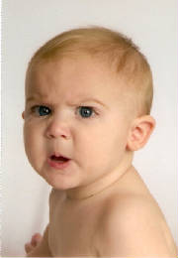
In order to trust- or retrust….
1- What are your expectations?
-Reasonable?
-Expressed?

Slide 18
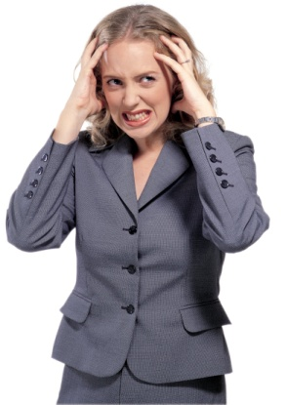
Relationship Expectations
Realistic
Unrealistic
Basic Wants and needs | Unattainable Wish List
Internal Belief System | Unexpected Emotional Reactions
Conscious
Unconscious
Kevinhinckleylpc.com

Slide 19
In order to trust- or retrust….
1- What are your expectations?
-Reasonable?
-Expressed?
2- Transparency
3- Risk!
4- Time
5- Gratitude prayer

