Slide 1
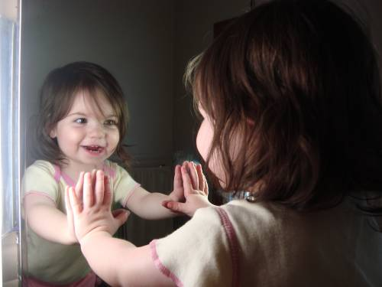
The Atonement and Self Image
www.kevinhinckley.com

Slide 2
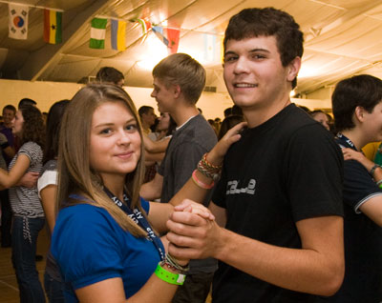
Top 10 EFY Pickup Lines!
10- Can I see your tag? Oh, that's what I thought... Made In Heaven.
9- Do you go to EFY? Cause I'm Especially For You.
8- Are you a Gadianton Robber? Because you stole my heart!
7- They told me that I'd feel the spirit at church, not that I'd see an angel!
6- Don't I know you from the pre-existence?
5- Even with the Liahona, I get lost in your eyes.
4- I miss you like the Book of Mormon missed the Bible during the Great Apostasy.
3- The tree of life called, it wants it's sweetness back.
2- All girls are beautiful daughters of God, but, wow! He went overboard on you!
1- Is your name Virtue? Because you garnish my thoughts unceasingly.

Slide 3
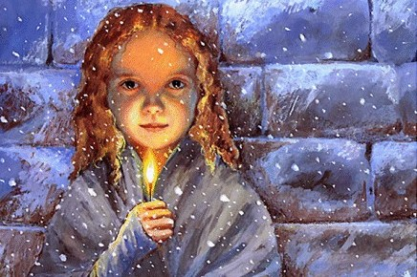

Slide 4
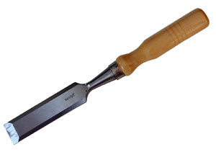
For Starters

Slide 5
The Apostle Paul’s Viewpoint…
1 Cor 12
21 And the eye cannot say unto the hand, I have no need of thee: nor again the head to the feet, I have no need of you.
22 Nay, much more those members of the body, which seem to be more feeble are necessary:
23 And those members of the body, which we think to be less honourable, upon these we bestow more abundant honour;
and our uncomely parts have more abundant comeliness.
24 For our comely parts have no need: but God hath tempered the body together,
having given more abundant honour to that part which lacked:
30 Have all the gifts of healing? do all speak with tongues? do all interpret?
31 But covet earnestly the best gifts:
and yet shew I unto you a more excellent way.

Slide 6
The Apostle Paul’s Viewpoint…
1 Cor 13
1 Though I speak with the tongues of men and of angels, and have not charity, I am become as sounding brass
3 And though I bestow all my goods to feed the poor, …and have not charity, it profiteth me nothing.
9 For we know in part and we prophesy in part.
10 But when that which is perfect is come, then that which is in part shall be done away.
11 When I was a child, I spake as a child, I understood as a child, I thought as a child:
but when I became a man, I put away childish things.
12 For now we see through a glass, darkly;
but then face to face:
now I know in part;
but then shall I know even as also I am known.
13 And now abideth faith, hope, charity, these three; but the greatest of these is charity.

Slide 7
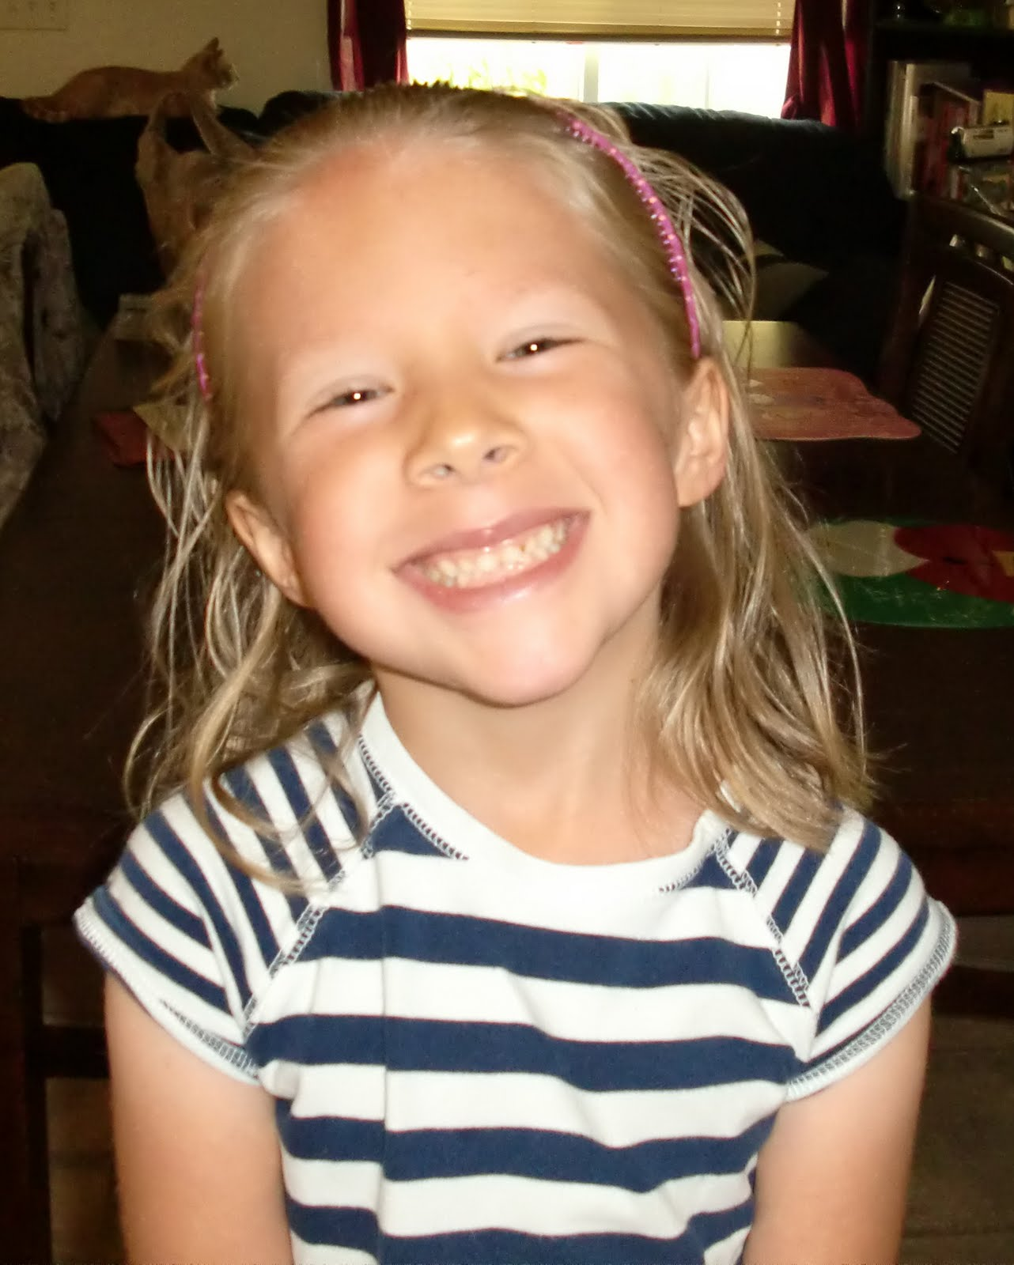
Elder CS Lewis
It is a serious thing living in a society of possible gods and goddesses, to remember that the dullest and most uninteresting person you can talk to may one day be a creature which, if you say it now, you would be strongly tempted to worship, …
It is in the light of these overwhelming possibilities, it is with the awe and the circumspection proper to them, that we should conduct all our dealings with one another, all friendships, all loves, all play, all politics.
There are no ordinary people. You have never talked to a mere mortal. Nations, cultures, arts, civilisations — these are mortal, and their life is to ours as the life of a gnat.
But it is immortals whom we joke with, work with, marry, snub, and exploit …
Next to the Blessed Sacrament itself, your neighbour is the holiest object presented to your senses.
The Weight of Glory 45-46

Slide 8
The Image Cycle
Guides
Confirms
Self
Image
Choices

Slide 9
Negative
Self Image
Negative Messages
- Ages 10-14
- One Time Learning
Painful Experiences
- Perception is reality
Faulty Beliefs
About God
About Prayer
Act

Slide 10
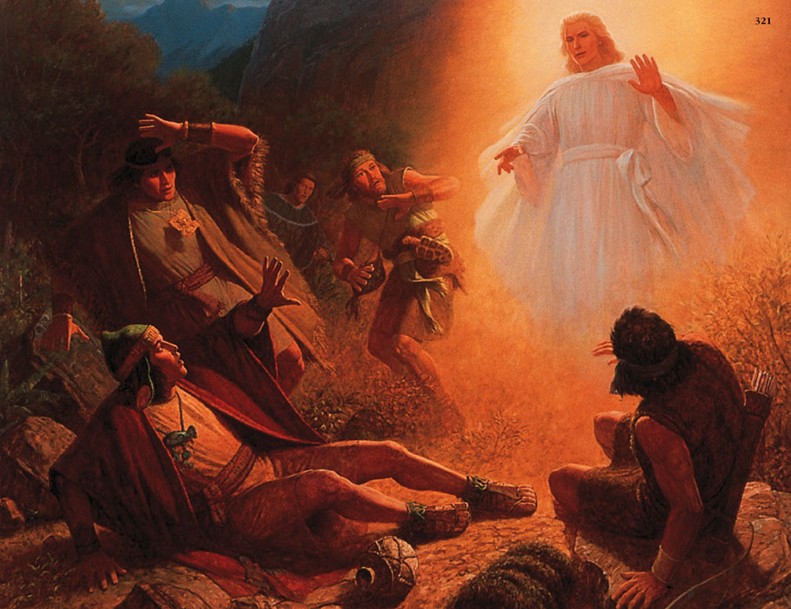
Power of Thoughts
12 But I was racked with eternal torment, for my soul was …racked with all my sins.
13 Yea, I did remember all my sins and iniquities, for which I was tormented with the pains of hell; yea, I saw that I had rebelled against my God, and that I had not kept his holy commandments.
14 Yea….the very thought of coming into the presence of my God did rack my soul with inexpressible horror.
15 Oh, thought I, that I could be banished and become extinct both soul and body, that I might not be brought to stand in the presence of my God, to be judged of my deeds.
17 And it came to pass …, I remembered also to have heard my father prophesy unto the people concerning the coming of one Jesus Christ, a Son of God, to atone for the sins of the world.
18 Now, as my mind caught hold upon this thought, I cried within my heart: O Jesus, thou Son of God, have mercy on me, who am in the gall of bitterness, and am encircled about by the everlasting chains of death.
19 And now, behold, when I thought this, I could remember my pains no more; yea, I was harrowed up by the memory of my sins no more.
20 And oh, what joy, and what marvelous light I did behold; yea, my soul was filled with joy as exceeding as was my pain!
Alma 40:14
Now this is the state of the souls of the wicked, yea, in darkness,
and a state of awful, fearful looking for the fiery indignation of the wrath of God upon them;
thus they remain in this state, as well as the righteous in paradise, until the time of their resurrection.

Slide 11
Question
Who’s lens do you see you through?

