Slide 1
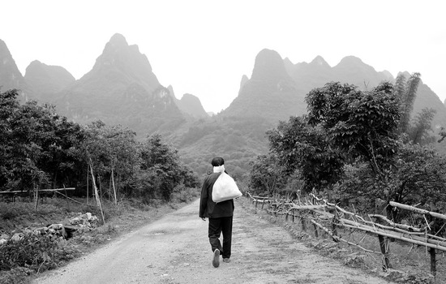
Scars on the Soul
www.kevinhinckley.com

Slide 2
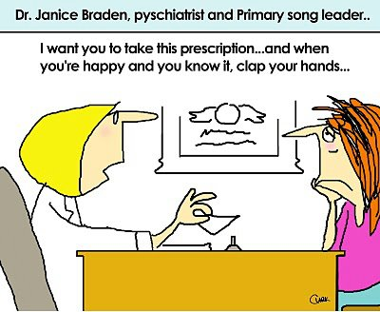

Slide 3
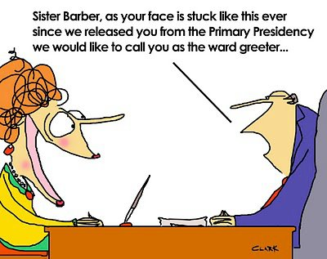

Slide 4
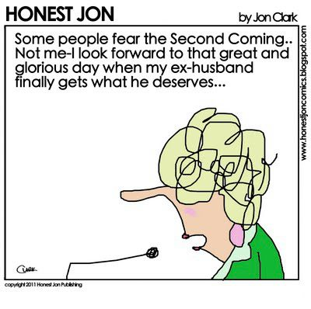

Slide 6
Basic Truth….
Your perception
becomes your reality.
Your personal history
Is based on
How you interpreted it

Slide 7
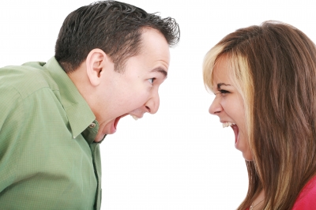
For Instance….

Slide 8
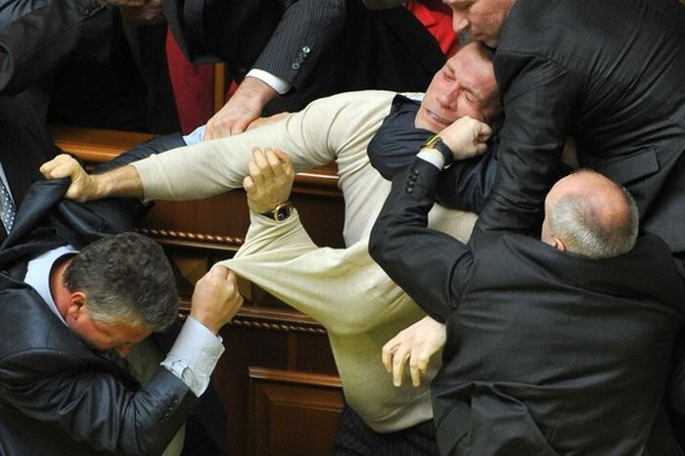

Slide 9
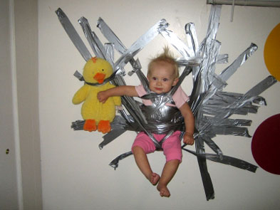

Slide 10
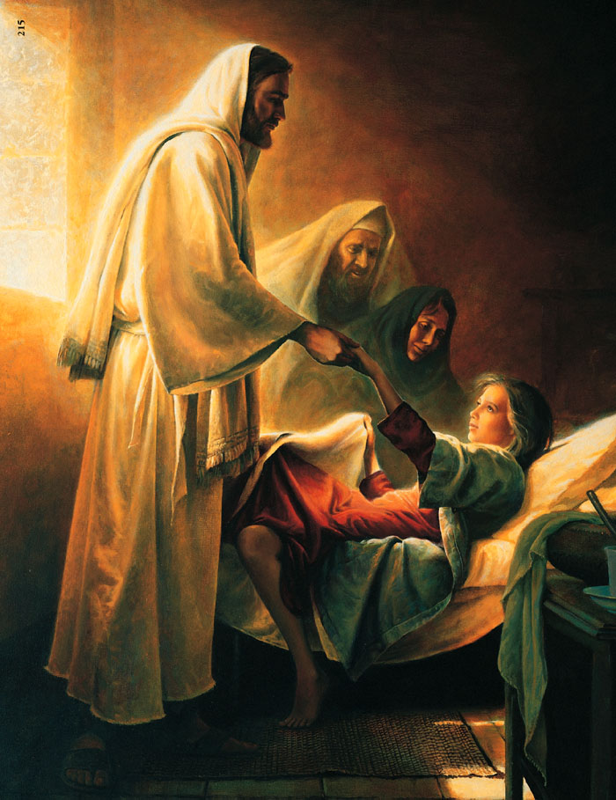
John “the Beloved”
1 John 4:19
There is no fear in love; but perfect love (his love) casteth out fear; because fear hath torment…
We love him, because he first loved us.

Slide 11
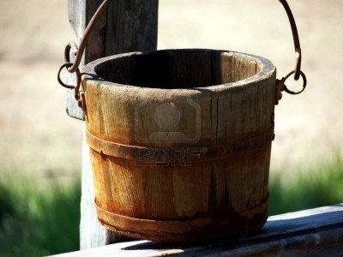
The Lord
Ourselves
Others
Sin
Criticism
Acts of others
“Loved”
Bucket

Slide 12
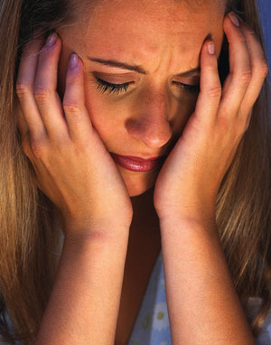
The Terrible Dilemma
Past Traumatic Events
Choice #1
Painful Event
Nothing You Could Do- Random
Could Happen Again
Choice #2
Painful Event
You Somehow Caused It
Might not happen again- If you learn and change
But- You must carry the guilt of the event

Slide 13
The Lord
Ourselves
Others
Sin
Criticism
Acts of others
“Loved”
Bucket

Slide 14
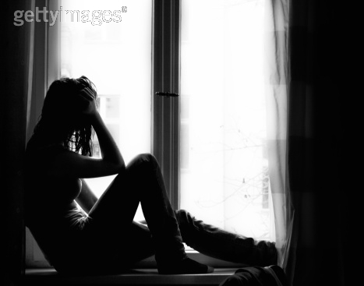
Trauma Guilt
The constant sense of feeling guilty, for things you are not responsible for….
The inability to accept love and acceptance as real and genuine.

Slide 15
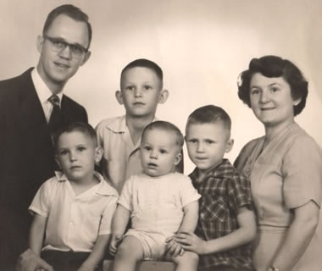
Critical Skills
Developmental Stages
Age
Preschool
7-9
10-12
13-16
16-19
19-25
Focus
Family
Law and Order
Hero Worship
Peers
Independence
Idealism/Decision Making

Slide 16
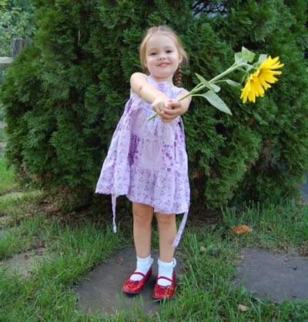
Word of Warning
Repressed and/or Recovered
Memories

Slide 17
Challenging the Foundation
Past
Trauma
False Perceptions
- Self
- God
Irrational Guilt
Natural Grief and Loss

Slide 18
Twin Battles
False Self Perceptions
It was my fault
I am broken and unfixable
I hurt other people
Other people can “see” my faults
They want to hurt me
False God Perceptions
He doesn’t love me as much as others
I am still be punished by my past choices
I’m not learning the lessons I need to learn
I’m unworthy

Slide 19
Triggers

Slide 20
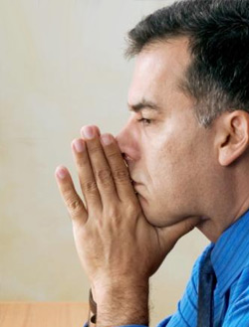
Coping Skills
Anxiety
Numbing
Angry and
Brittle
Sleep
Problems
Loss of Time
Indeciveness

Slide 21
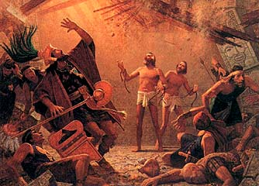
Alma and Amulek
Alma 14:9-26
And it came to pass that they took Alma and Amulek, and carried them forth to the place of martyrdom, that they might witness the destruction of those who were consumed by fire.
10 And when Amulek saw the pains of the women and children who were consuming in the fire, he also was pained; and he said unto Alma: How can we witness this awful scene? Therefore let us stretch forth our hands, and exercise the power of God which is in us, and save them from the flames.
11 But Alma said unto him: The Spirit constraineth me that I must not stretch forth mine hand; for behold the Lord receiveth them up unto himself, in glory;
and he doth suffer that they may do this thing, or that the people may do this thing unto them, according to the hardness of their hearts, that the judgments which he shall exercise upon them in his wrath may be just; and the blood of the innocent shall stand as a witness against them, yea, and cry mightily against them at the last day.
12 Now Amulek said unto Alma: Behold, perhaps they will burn us also.
13 And Alma said: Be it according to the will of the Lord. But, behold, our work is not finished; therefore they burn us not.
16 And it came to pass that Alma and Amulek, Amulek having forsaken all his gold, and silver, and his precious things, which were in the land of Ammonihah, for the word of God, he being rejected by those who were once his friends and also by his father and his kindred;

Slide 22
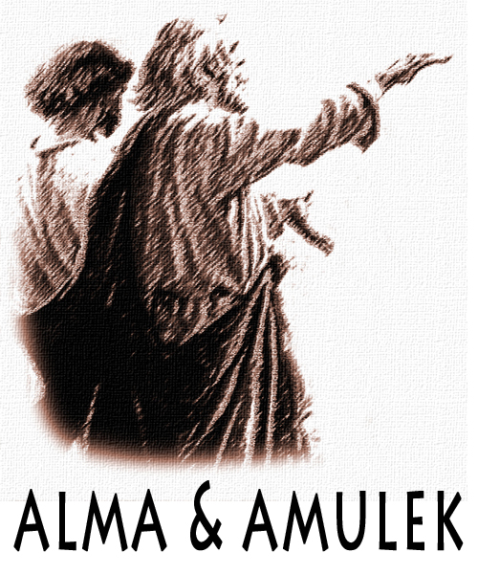
Help….
Alma 15:
16 And it came to pass that …Amulek having forsaken all his gold, and silver, and his precious things, which were in the land of Ammonihah, for the word of God, he being rejected by those who were once his friends and also by his father and his kindred;
18 Now as I said, Alma having seen all these things, therefore he took Amulek
…to his own house, and did administer unto him in his tribulations, and strengthened him in the Lord.

Slide 23
Healing From Trauma
Spiritual
Physical
Healing
Principles
Emotional

