Slide 1
Lady Wisdom
www.kevinhinckley.com

Slide 11
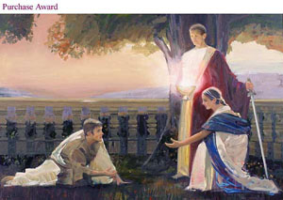
Hebrew Female Nouns
Wisdom
Wisdom crieth without; she uttereth her voice in the streets (Proverbs 1:21)
Understanding
Doth not wisdom cry? And understanding put forth her voice? (Proverbs 8:1)
Mercy
…also mercy claimeth all which is her own…. (Alma 42:23)

Slide 12
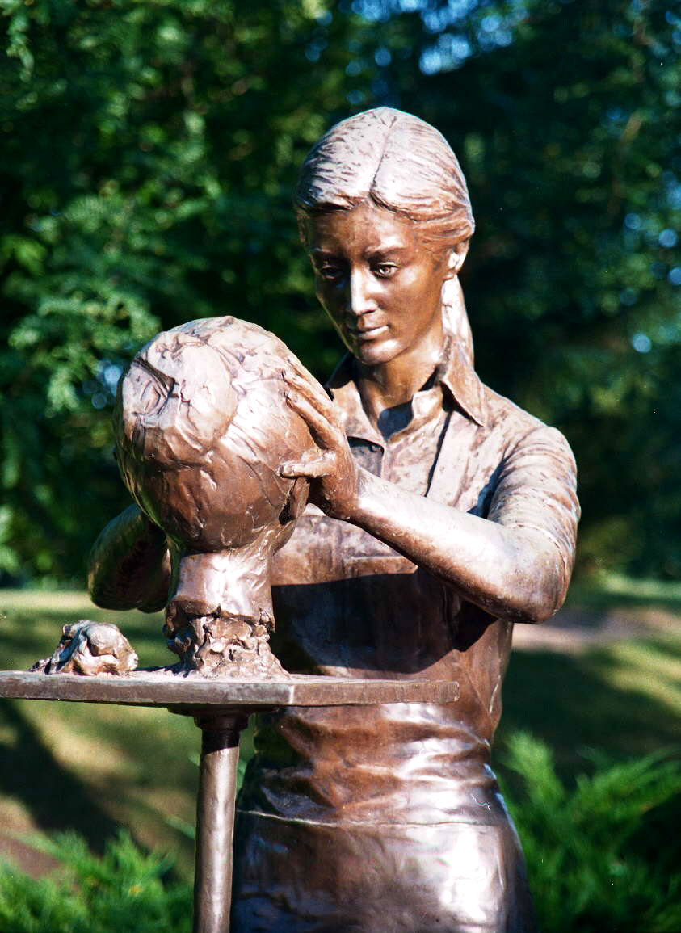
Lady Wisdom
Proverbs 3
¶ Happy is the man that findeth wisdom and the man that getteth understanding
15 She is more precious than rubies: and all the things thou canst desire are not to be compared unto her.
16 Length of days is in her right hand; and in her left hand riches and honour.
17 Her ways are ways of pleasantness and all her paths are peace.
18 She is a tree of life to them that lay hold upon her: and happy is every one that retaineth her.

Slide 13
Today
In Search of Wisdom!

Slide 14
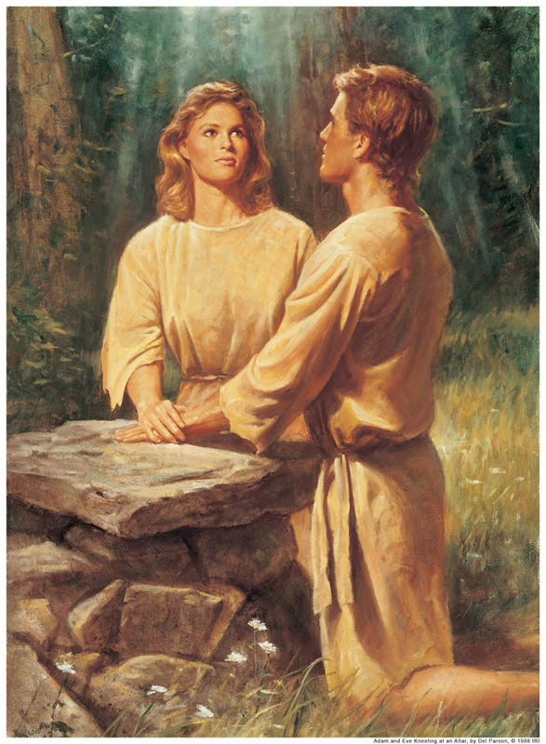
Mother Eve
Moses 4:
And [Lucifer] said unto the woman: Yea, hath God said—Ye shall not eat of every tree of the garden?
8 And the woman said unto the serpent: We may eat of the fruit of the trees of the garden;
9 But of the fruit of the tree which thou beholdest in the midst of the garden, God hath said—Ye shall not eat of it, neither shall ye touch it, lest ye die.
10 And the serpent said unto the woman: Ye shall not surely die;
11 For God doth know that in the day ye eat thereof, then your eyes shall be opened, and ye shall be as gods, knowing good and evil.
12 And when the woman saw that the tree was good for food, and that it became pleasant to the eyes, and a tree to be desired to make her wise, she took of the fruit thereof, and did eat,

Slide 15
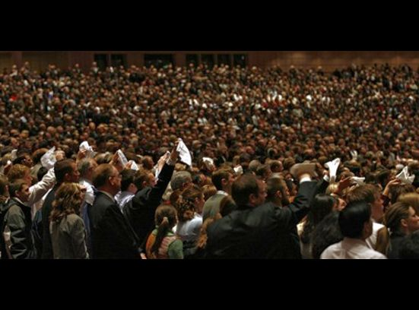
Rule #1 Seek to Tarry
3 Nephi 17
1 Behold, now it came to pass that when Jesus had spoken these words he looked round about again on the multitude, and he said unto them: Behold, my time is at hand.
3 Therefore, go ye unto your homes, and ponder upon the things which I have said, and ask of the Father, in my name, that ye may understand, and prepare your minds for the morrow, and I come unto you again.
5 And it came to pass that when Jesus had thus spoken, he cast his eyes round about again on the multitude,
and beheld they were in tears, and did look steadfastly upon him as if they would ask him to tarry a little longer with them.
6 And he said unto them: Behold, my bowels are filled with compassion towards you.
7 Have ye any that are sick among you? Bring them hither. Have ye any that are lame, or blind, or halt, or maimed, or leprous, or that are withered, or that are deaf, or that are afflicted in any manner? Bring them hither and I will heal them, for I have compassion upon you; my bowels are filled with mercy.

Slide 16
Interesting Sequence…
3 Nephi 17: 12
…they brought their little children and set them down upon the ground round about him,
and Jesus stood in the midst…
And … he commanded the multitude that they should kneel down upon the ground.
Jesus groaned within himself and said: Father, I am troubled because of the wickedness of the people of the house of Israel
…And when he had said these words, he himself also knelt upon the earth; and behold he prayed unto the Father…
And as they looked to behold they cast their eyes towards heaven, and they saw the heavens open, and they saw angels descending out of heaven as it were in the midst of fire; and they came down and encircled those little ones about
Ministering Angels
The People
The Children
The
Savior

Slide 17
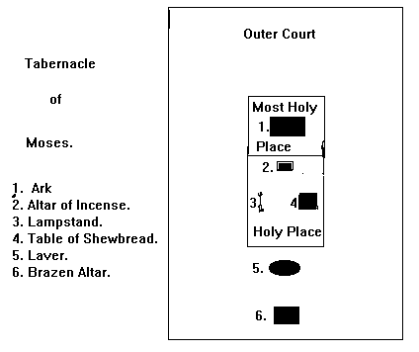
Interesting Sequence…
Ministering Angels
3 Nephi 17: 12
…they brought their little children and set them down upon the ground round about him,
and Jesus stood in the midst…
And … he commanded the multitude that they should kneel down upon the ground.
Jesus groaned within himself and said: Father, I am troubled because of the wickedness of the people of the house of Israel
…And when he had said these words, he himself also knelt upon the earth; and behold he prayed unto the Father…
And as they looked to behold they cast their eyes towards heaven, and they saw the heavens open, and they saw angels descending out of heaven as it were in the midst of fire; and they came down and encircled those little ones about
The People
The Children
The
Savior

Slide 18
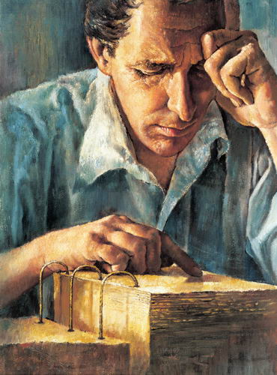
Gifts
D&C 5
33 And there are many that lie in wait to destroy thee from off the face of the earth; and for this cause, that thy days may be prolonged, I have given unto thee these commandments.
34 Yea, for this cause I have said: Stop, and stand still until I command thee, and I will provide means whereby thou mayest accomplish the thing which I have commanded thee.

Slide 19
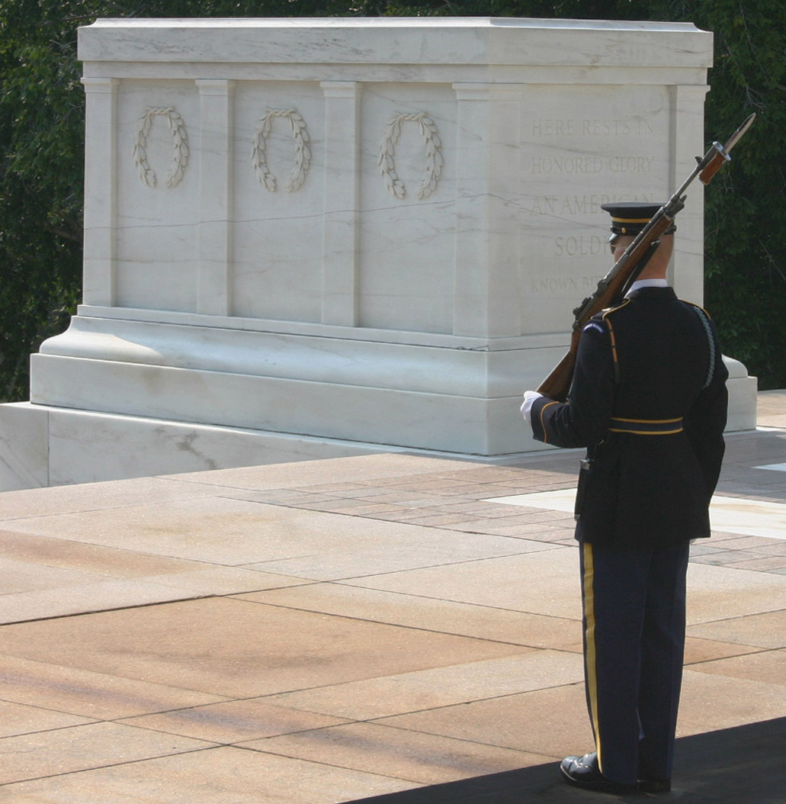
Rule #2:
Stop and Stand Still

Slide 20
Rule #3
Be Endlessly Curious

Slide 21
Proverbs 2
3 Yea, if thou criest after knowledge , and liftest up thy voice for understanding;
4 If thou seekest her as silver, and searches for her as for hid treasures;
5 Then shalt thou understand the fear of the LORD, and find the knowledge of God.
6 For the LORD giveth wisdom
10 ¶ When wisdom entereth into thine heart…knowledge is pleasant unto thy soul;

Slide 22
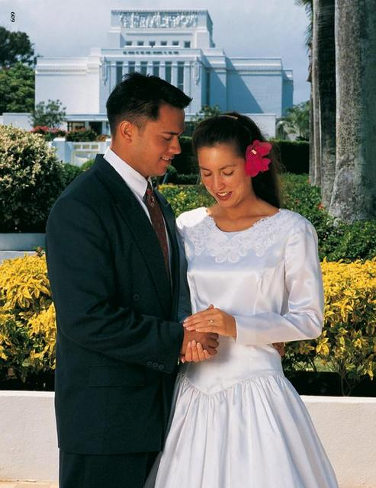
Rule #4
Wisdom is the gift given to the meek and obedient
James 3
13- Who is a wise [woman] and endued with knowledge among you? Let [her] show out of a good conversation [her] works with meekness of wisdom.
17- …the wisdom that is from above is first pure, then peaceable, gentle, and easy to intreated, full of mercy and good fruits, without partiality, and without hypocrisy

Slide 23
Russell M. Nelson
For you childless sisters and those without companions, remember the eternal timetable of the Lord is much longer than the lonely hours of your preparation or the total of this mortal life…
The spiritual rewards of motherhood are available to all women.
Nurturing the young, comforting the frightened, protecting the vulnerable, teaching and giving encouragement need not—and should not—be limited to our own children.

Slide 24
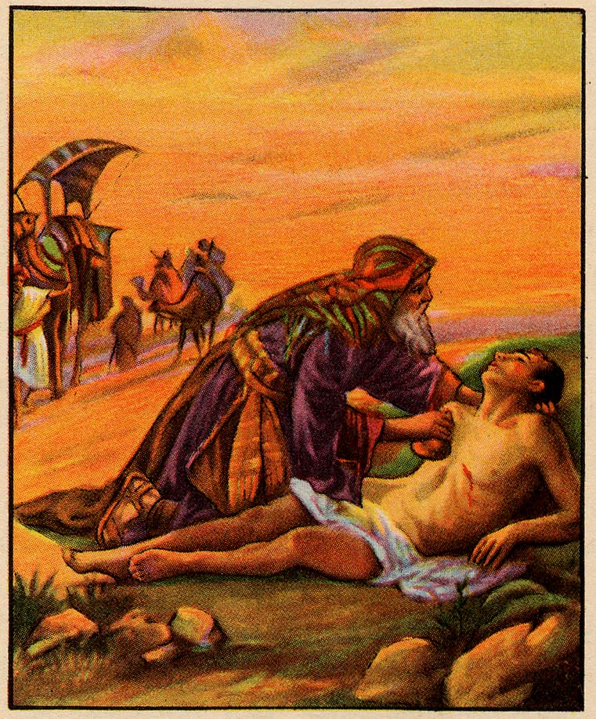
Elder Marvin J. Ashton
An understanding, loving heart is the pinnacle of all human emotions. As the Apostle Paul said, charity “beareth all things, believeth all things, hopeth all things, endureth all things.”
We come closest to becoming Christlike when we are charitable and understanding of others.
One may have many talents and knowledge but never acquire wisdom because he does not learn to be compassionate with his fellow man.
We will never approach godliness until we learn to love and lift.
Indifference to others and their plight denies us life’s sweetest moments of joy and service.

Slide 25
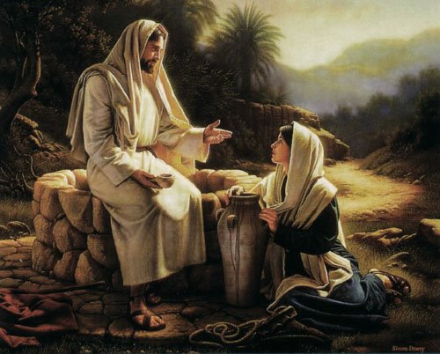
Pres President Dieter F. Uchtdorf Forget Me Nots
It’s wonderful that you have strengths.
And it is part of your mortal experience that you do have weaknesses.
God wants to help us to eventually turn all of our weaknesses into strengths, but He knows that this is a long-term goal.
He wants us to become perfect, and if we stay on the path of discipleship, one day we will.
It’s OK that you’re not quite there yet. Keep working on it, but stop punishing yourself.
Oct, 2011 Conference

