Slide 1
Mommy Power

Slide 2
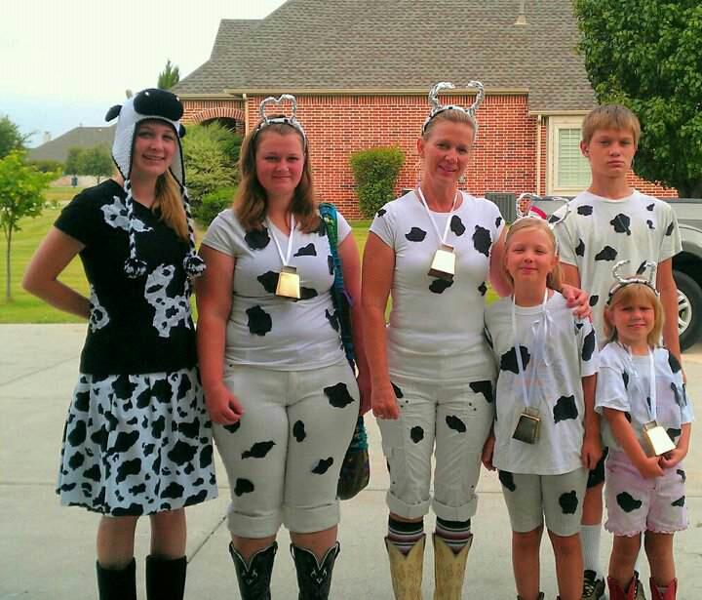
BTW,
Occasional Embarrassment Goes a Long Way!!

Slide 3
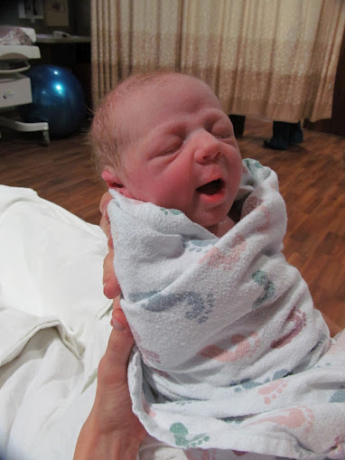

Slide 4
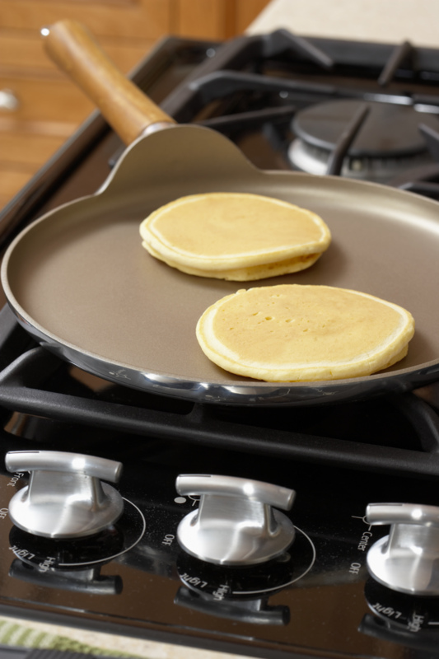
Mom

Slide 5
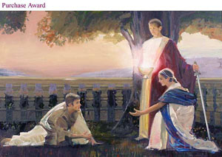
Hebrew Female Nouns
Wisdom
Wisdom crieth without; she uttereth her voice in the streets (Proverbs 1:21)
Understanding
Doth not wisdom cry? And understanding put forth her voice? (Proverbs 8:1)
Mercy
…also mercy claimeth all which is her own…. (Alma 42:23)

Slide 6
Question
Through us, do our children see a Plan of Rules,
or a Plan of Happiness?

Slide 7
JRR Tolkien
It does not do to leave a live dragon out of your calculations,
if you live near him….

Slide 8
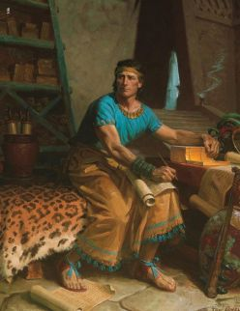
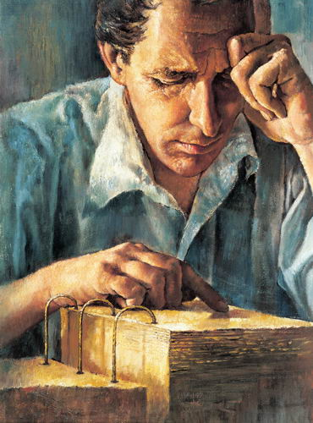
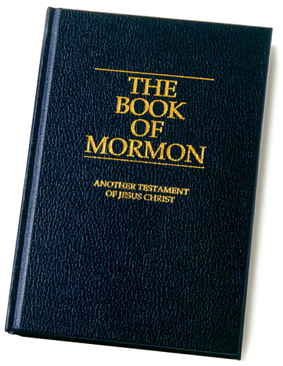
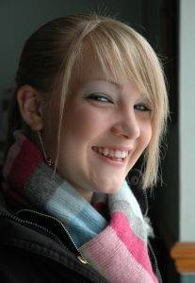
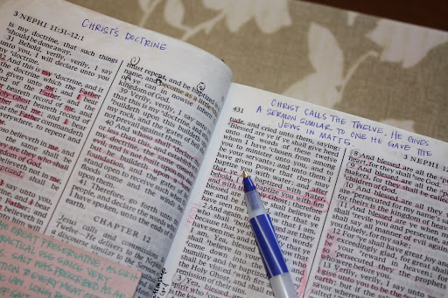

Slide 9
Lady wisdom (and parents) is in a constant search for truth. she hungers to know more. the scriptures are a place for her to learn and be taught. she sees the words of the prophets as a place to find answers and to access the spirit in order to learn. do our youth know that? do they see it in the way we speak of scriptures? do they see a light in our eyes when we speak of Mormon or Paul or alma?
Part of Lady Wisdoms task is a translator- she helps translate ancient lessons into current language so that her listeners can apply them.
In this way, the spirit of wisdom allows to her speak in tongues- indeed, the tongues of angels. To translate in a way that they are more able to understand.
Like Joseph, she becomes a conduit for the ancient words being taught "in their own language" and in a way they will draw of the same spirit as she teaches. She too becomes a urim and thummin, the spirit following through her and bringing the words-and intent-of the ancients to life.

Slide 10
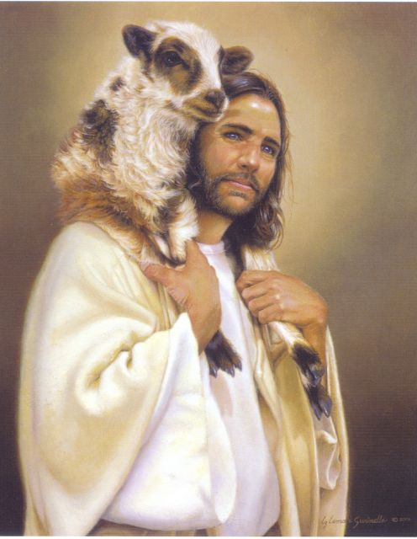
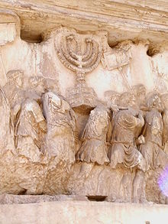
For Instance
Matt 11
28 ¶ Come unto me, all ye that labour and are heavy laden, and I will give you rest.
29 Take my yoke upon you, and learn of me; for I am meek and lowly in heart; and ye shall find rest unto your souls.
30 For my yoke is easy, and my burden is light.
Luke 15
4 What man of you, having an hundred sheep, if he lose one of them, doth not leave the ninety and nine in the wilderness, and go after that which is lost, until he find it?
5 And when he hath found it, he layeth it on his shoulders, rejoicing…

Slide 11
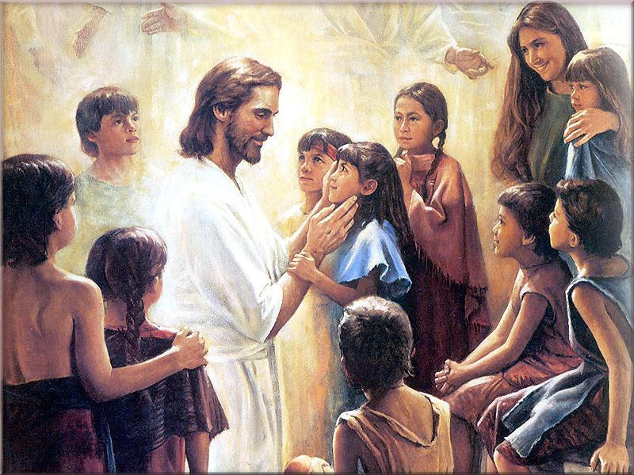
2 Nephi 25
2 Nephi 25:
…for this end was the law given…and we are made alive in Christ because of our faith…
And we talk of Christ, we rejoice in Christ, we preach of Christ, we prophesy of Christ….
That our children may know to what source they may look for a remission of their sins

Slide 12
Good
Honey, lets talk about what Jesus did for us

Slide 13
Better…
Honey, lets talk about what Jesus did for us
Now, in my life….

Slide 14
Best!
Honey, lets talk about what Jesus did for us
Now, in my life….
When was the last time you felt that way?

Slide 15
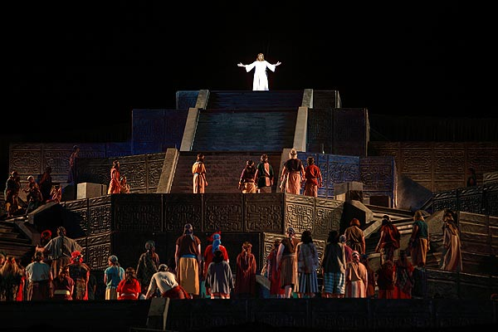
Personal Experience
3 Nephi 11
14 Arise and come forth unto me, that ye may thrust your hands into my side, and also that ye may feel the prints of the nails in my hands and in my feet,
that ye may know that I am the God of Israel, and the God of the whole earth, and have been slain for the sins of the world.
15 And it came to pass that the multitude went forth, and thrust their hands into his side, and did feel the prints of the nails in his hands and in his feet; and this they did do, going forth one by one until they had all gone forth, and did see with their eyes and did feel with their hands,
and did know of a surety and did bear record, that it was he, of whom it was written by the prophets, that should come.

Slide 16
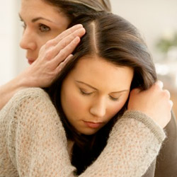
Youth and Self Esteem
BYU Study
“Mother’s connection, the emotional ties the youth felt to their mothers, had a direct relationship with self-esteem for all samples of young women and one sample of young men.
Mother’s Regulation, the setting of rules, monitoring compliance, and administering discipline was significantly related to self esteem…
Among LDS youth, parents emotional connections and regulation of teens behavior were both significant factors in understanding the teens’ feelings of self-esteem. Shield of Faith, p. 181

Slide 17
Youth and Self Esteem
BYU Study
“Parents who sit down with their teenage children and discuss family rules,
Such as responsibility for helping around the house, curfews, completion of homwork…score high on regulation.
When rules are violated, these parents administer the agreed-upon discipline, usually some type of grounding, loss of privilege, or extra chores.
Parents who provide this type of structure in the lives of their children help them realize the consequences of their behavior and also promote higher self-esteem. Shield of Faith, p. 181

Slide 18
Soft and Strong The Power of Meekness
Fogging and Broken Record
Fogging
That may be true…
I can see how you might believe that…
Probably,
Isn’t that horrible?
Yes, I probably am…
I know it feels that way…
You’re probably right…
That could be…
I know…
Sure sounds that way, doesn’t it?

Slide 19
Soft and Strong The Power of Meekness
Fogging and Broken Record
14 year old daughter: Mom, everyone is going to the mall tonight. Can I go?
Mom: Honey, you haven’t finished your homework. You need to stay home and do it.
Daughter: I’ll do it when I get home.
Mom: We agreed weeks ago you’d always do your homework first. You need to stay and do your homework.
Daughter: Mom! All my friends are going!
Mom: That may be true, but you need to do your home work.
Daughter: Don’t be so mean!
Mom: I know it feels like that, but you need to do your homework.
Daughter: You’re just afraid I’m going to get into trouble.
Mom: Probably. But you need to do your homework.
Daughter: Please! I’ll do the all the laundry for a week!
Mom: Thanks for the offer. But you need to do your homework.

Slide 20
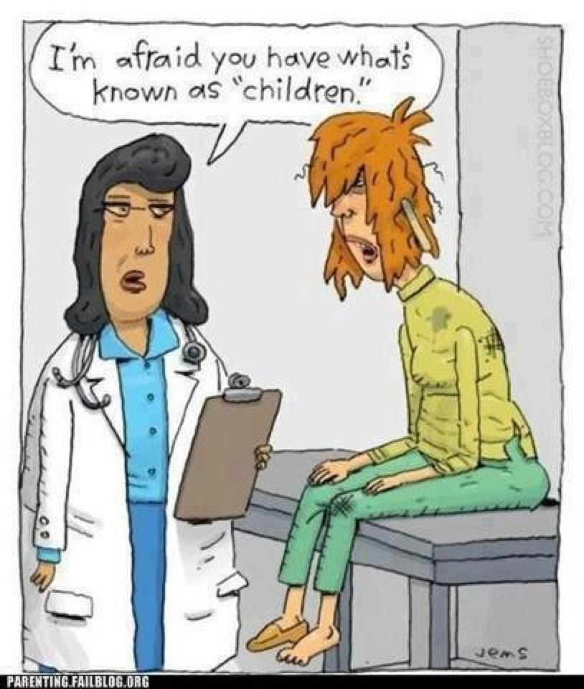

Slide 21
Brigham Young
"Let the father and mother, who are members of this Church and kingdom, take a righteous course, and strive with all their might never to do a wrong, but to do good all their lives;
if they have one child or one hundred children, if they conduct themselves towards them as they should, binding them to the Lord by their faith and prayers, I care not where those children go,
they are bound up to their parents by an everlasting tie, and no power on earth or hell can separate them from their parents in eternity; they will return again to the fountain from whence they sprang"
(in Journal of Discourses, 11:215; emphasis added).

Slide 22
Robert Millett
there seems to be, in the sermons and writings of the prophets, the quiet but soul-satisfying message that the alms of the prayers of the righteous do come up into the ears of the Lord …
that righteous parents' loyalty to their covenants will not be overlooked; that no amount of suffering of the faithful in behalf of their posterity will be for naught;
and that there is power, remarkable power, in the covenant to save those who will be saved.
As Elder Packer suggested, it may be that the power of evil in these last days is so oppressive that it chokes or restrains the proper exercise of agency.
One day that will change.

Slide 23
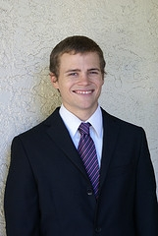
A young woman has great power over us young men. If we are so lucky as to date young women who bring out everything that is good and praiseworthy in our lives, we will be so blessed…
I love it when a young woman misses me when I have to miss seminary…
I like it when she makes me magnify my priesthood and help me see my future….

Slide 24
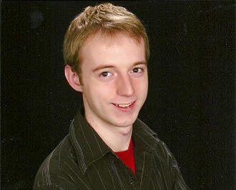
I like it when young women are feminine and gentle. When they act this way I find myself wanting to be a better young man around them.
Why do some girls think they have to be so loud and tough?
I think that a young woman’s strength is her womanhood…

Slide 25
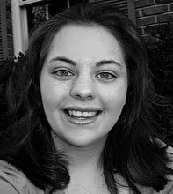
I don’t know one young man that will call you up, ask you politely out on a date, plan a fun filled date, dress classy and nice, come and pick you up,
pay for everything and then bring you home and walk you up to the door while saying goodnight and thanks.
All I get is guys that just want to hang out. I am sick of “so hey, what are you doing..what do you want to do…?

Slide 26
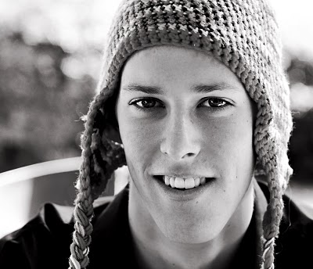
All the girls I know want their very own boyfriends…
I think they are in love with being in love…
Why doesn’t anybody date anymore? If you ask different girls out they all end up hating you.
I wish we could date and just have a good time and not be so serious.

