Slide 1
Hurts, Habits and Hangups
www.kevinhinckley.com

Slide 2
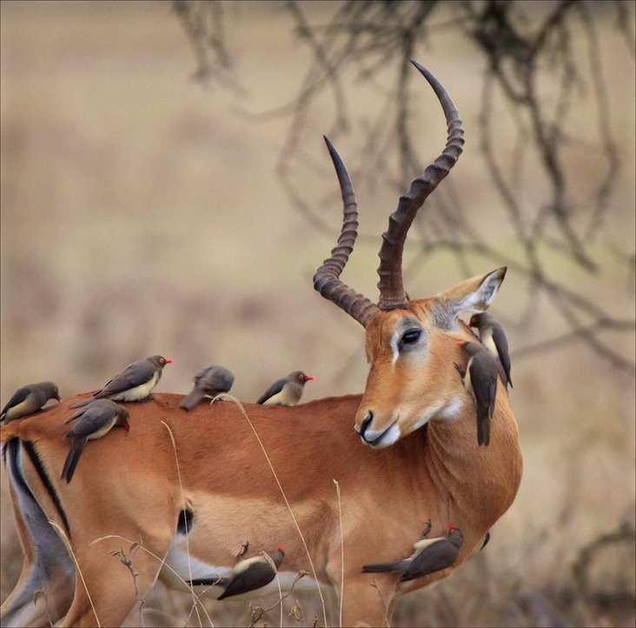
Nursery Kids- during church

Slide 3
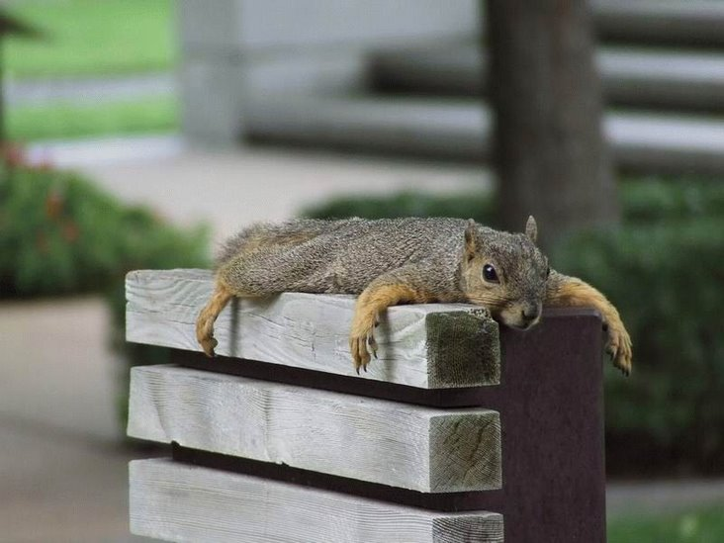
Nursery Leaders— after church…

Slide 4
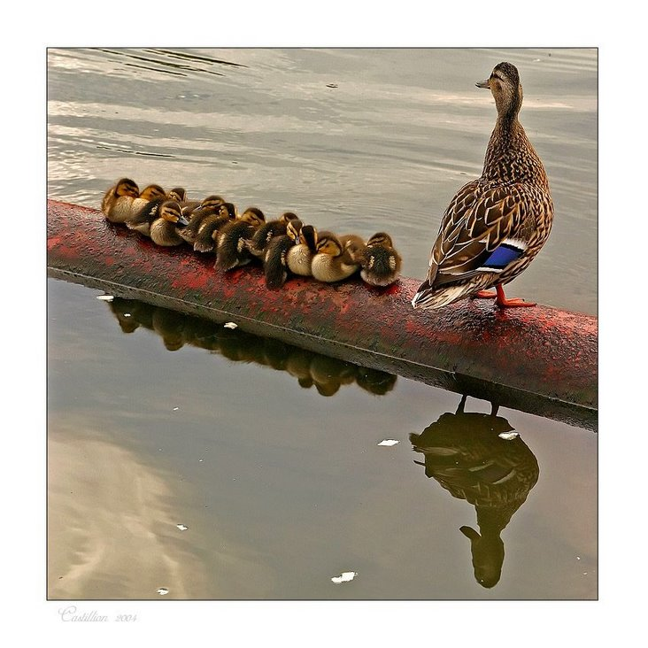
Look, it’s the Sunbeams!

Slide 5
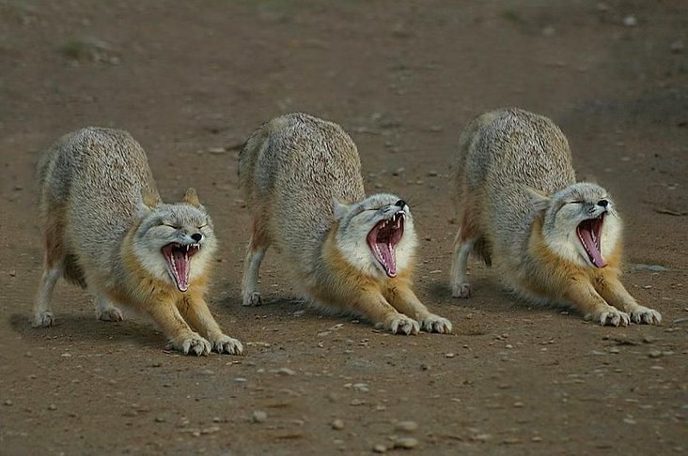
Deacons, during the High Councilor Talk…

Slide 6
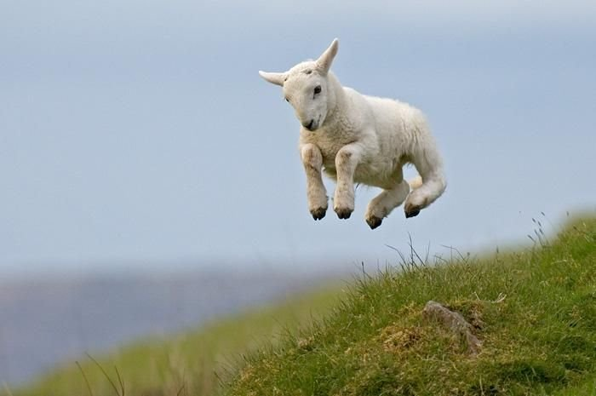
8 year old boy— after church

Slide 7
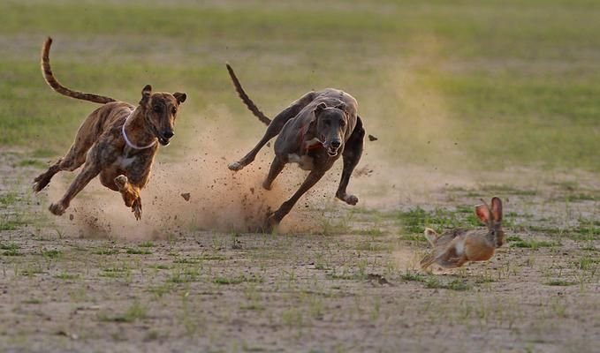
Priests- at the Stake dance…

Slide 8
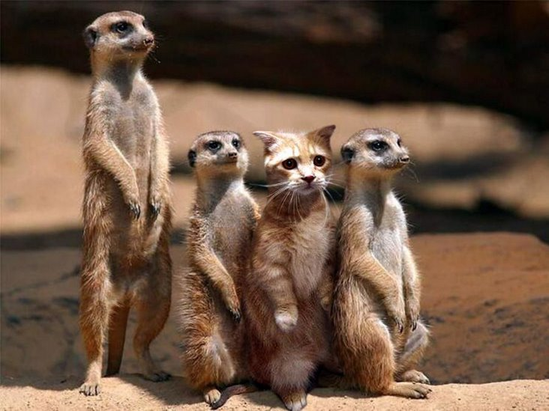
Can you spot the investigator?

Slide 9
Seasons in our Life
Scouts!

Slide 10
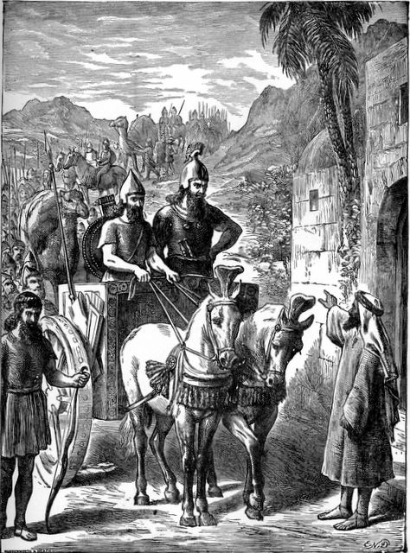
2 Kings 5
Now Naaman, captain of the host of the king of Syria, was a great man with his master, and honourable, because by him the Lord had given deliverance unto Syria; he was also a mighty man of valour,
but he was a leper.
[And the Hebrew maid of his wife] said unto her mistress, Would God my lord were with the prophet that is in Samaria! For he would recover him of his leprosy.

Slide 11
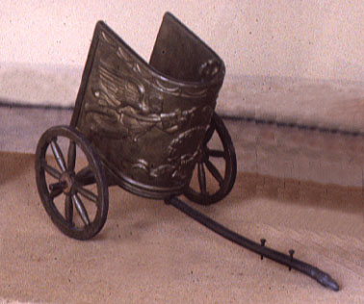
Elisha’s Response?
So Naaman came with his horses and with his chariot, and stood at the door of the house of Elisha.
And Elisha sent a messenger unto him, saying, Go and wash in Jordan seven times, and thy flesh shall come again to thee, and thou shalt be clean.

Slide 12
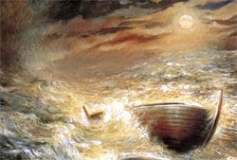
The Jaradite Wilderness
Ether 2:14,19
14 And it came to pass at the end of four years that the Lord came again unto the brother of Jared, and stood in a cloud and talked with him. And for the space of three hours did the Lord talk with the brother of Jared, and chastened him because he remembered not to call upon the name of the Lord.
16 And the Lord said: Go to work and build, after the manner of barges which ye have hitherto built.
17 And they were built after a manner that they were exceedingly tight, even that they would hold water like unto a dish; and the bottom thereof was tight like unto a dish…
18 And it came to pass that the brother of Jared cried unto the Lord, saying: O Lord, I have performed the work which thou hast commanded me, and I have made the barges according as thou hast directed me.

Slide 13
Three Problems
19 And behold, O Lord, in them there is no light; whither shall we steer? And also we shall perish, for in them we cannot breathe, save it is the air which is in them; therefore we shall perish.
Do This…
20 And the Lord said unto the brother of Jared: Behold, thou shalt make a hole in the top, and also in the bottom; and when thou shalt suffer for air thou shalt unstop the hole and receive air…
Trust Me…
24 For behold, ye shall be as a whale in the midst of the sea; for the mountain waves shall dash upon you. Nevertheless, I will bring you up again out of the depths of the sea;
You Must Act
23 And the Lord said unto the brother of Jared: What will ye that I should do that ye may have light in your vessels?

Slide 14
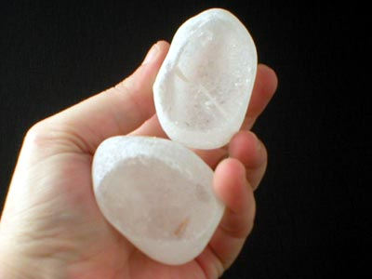
The Jaradite Wilderness
Ether 3: 2-5
2 O Lord, thou hast said that we must be encompassed about by the floods. Now behold, O Lord, and do not be angry with thy servant because of his weakness before thee;
for we know that thou art holy and dwellest in the heavens, and that we are unworthy before thee; because of the fall our natures have become evil continually; nevertheless,
O Lord, thou hast given us a commandment that we must call upon thee, that from thee we may receive according to our desires.
3 Behold, O Lord, thou hast smitten us because of our iniquity, and hast driven us forth, and for these many years we have been in the wilderness;
nevertheless, thou hast been merciful unto us.
O Lord, look upon me in pity, and turn away thine anger from this thy people, and suffer not that they shall go forth across this raging deep in darkness;
but behold these things which I have molten out of the rock.

Slide 15
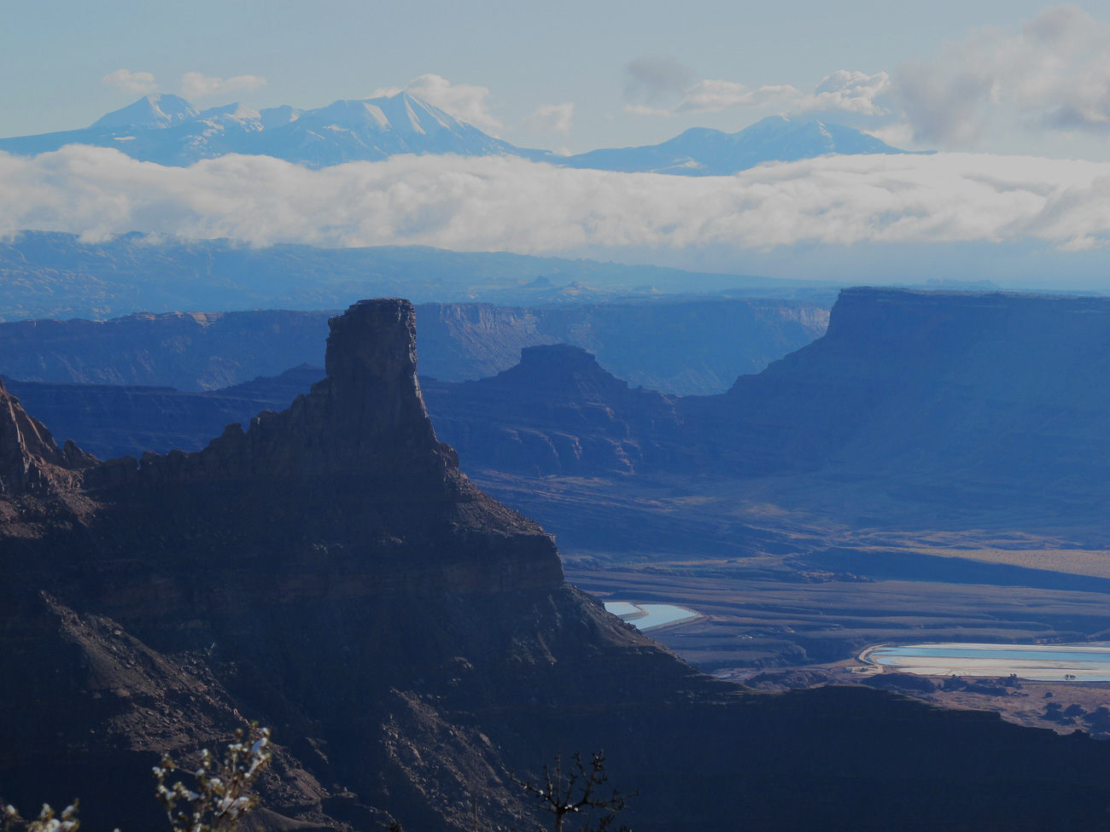
Barges to Build?
Relationship to mend
Forgiveness
Defiant child
Difficult calling
Loss of a dream
Rebuilding shattered confidence
Financial ruin
Battered Marriage
Suddenly Single
Debilitating Illness
Betrayal
Vicious rumors and personal attacks
Unkind church leaders
History of trauma and/or abuse
Unrelenting addiction or weakness

Slide 16
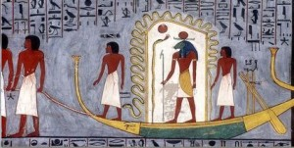
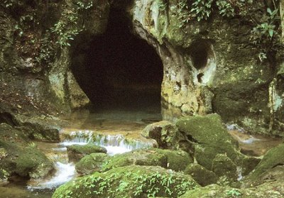
Rule #1
Helaman 3:28-30
Yea, thus we see that the gate of heaven is open unto all, even to those who will believe on the name of Jesus Christ, who is the Son of God.
Yea, we see that whosoever will may lay hold upon the word of God, which is quick and powerful,
which shall …lead the man of Christ in a strait and narrow course across that everlasting gulf of misery which is prepared to engulf the wicked—
And land their souls, yea, their immortal souls, at the right hand of God in the kingdom of heaven, to sit down with Abraham, and Isaac, and with Jacob, and with all our holy fathers, to go no more out.

Slide 17
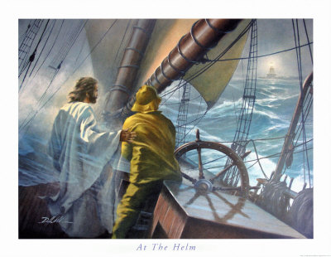
Critical Principle
Stay in the Boat!

Slide 18
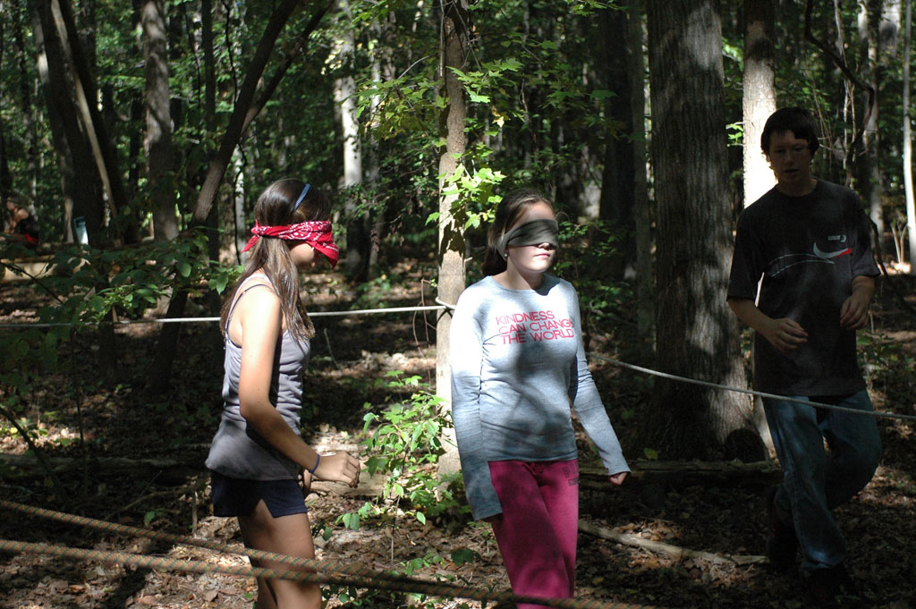
Blind Maze

Slide 19
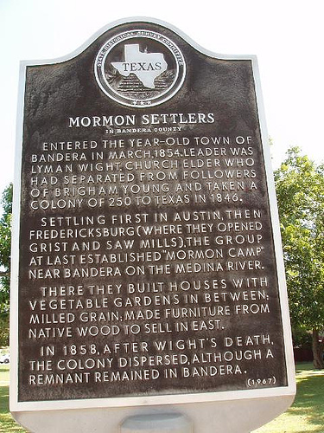
The Lord’s Pattern to Avoid Deception
D&C 52
12 And let my servant Lyman Wight beware, for Satan desireth to sift him as chaff.
13 And behold, he that is faithful shall be made ruler over many things.
14 And again, I will give unto you a pattern in all things, that ye may not be deceived; for Satan is abroad in the land, and he goeth forth deceiving the nations—
15 Wherefore he that prayeth, whose spirit is contrite, the same is accepted of me if he obey mine ordinances.
16 He that speaketh, whose spirit is contrite, whose language is meek and edifieth, the same is of God if he obey mine ordinances.
17 And again, he that trembleth under my power shall be made strong, and shall bring forth fruits of praise and wisdom, according to the revelations and truths which I have given you.

Slide 20
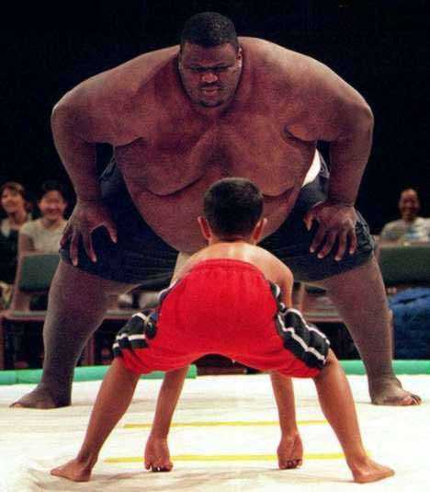
Rule #2 Bring What You Have
Brother of Jared brought newly hewn stones
Nephi brought a rough bow and homemade tools
Lehi brought a tent
A boy’s meager lunch fed 5000
David brought a simple sling
Captain Moroni had a torn coat
The widow had a little oil and some meal
Joseph Smith brought a question
Peter and James had no silver and gold but had the priesthood
Paul brought a whiney voice and thorn in the flesh
Spencer W. Kimball brought no voice
Moroni couldn’t write- but he did.
You have a spiritual gift and an endowment of power

Slide 21
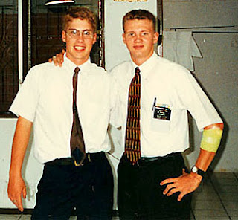
Therefore….
D&C 35
13 Wherefore, I call upon the weak things of the world, those who are unlearned and despised, to thrash the nations by the power of my Spirit;
14 And their arm shall be my arm, and I will be their shield and their buckler; and I will gird up their loins,
and they shall fight manfully for me; and their enemies shall be under their feet;
and I will let fall the sword in their behalf, and by the fire of mine indignation will I preserve them.

Slide 22
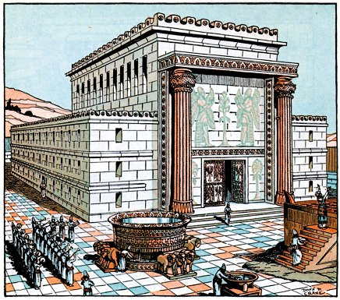
The Law of Moses
Three Types of Sacrifices/Offerings
Trespass (Guilt) Offerings
2) Burnt Offerings
-Burning of the whole animal
-Whole Surrender
-Constant, daily offering
3) Peace Offerings
-At peace
-Gratitude, gladness

Slide 23
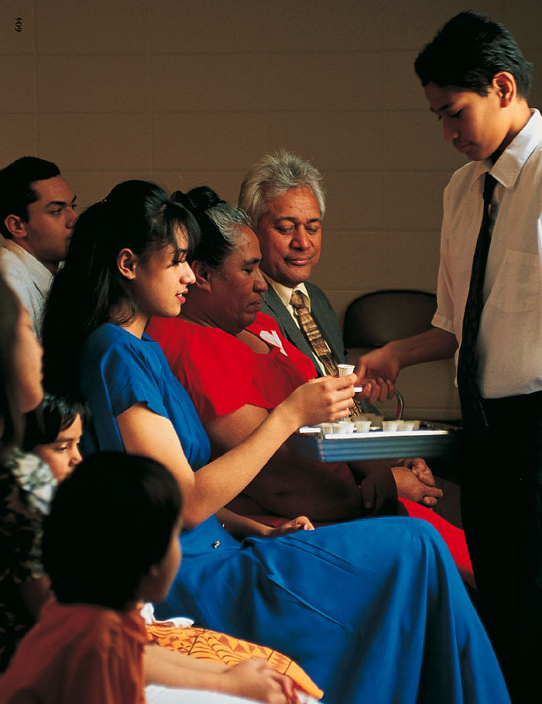
Law of Moses
Sin Offerings
Burnt Offerings
Peace Offerings
Sacrament
Forgiveness of our sins
Surrender:
Offer our whole time, talents and efforts
We Offer the Lord:
Gratitude, Love

Slide 24
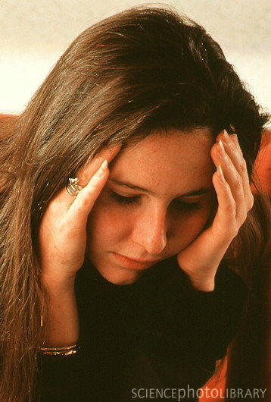
Elder CS Lewis
I still think the prayer without words is the best - if one can really achieve it…To pray successfully without words one needs to be "at the top of one's form."
…When the golden moments come, when God enables one really to pray without words, who but a fool would reject the gift? But He does not give it - anyway not to me - day in, day out.
My mistake was …thinking we can do always what we can do sometimes....
For me words are...secondary. They are only an anchor. Or, shall I say, they are the movements of a conductor's baton: not the music.
Letters to Malcom, Chiefly about Prayer, p. 11

