Slide 1
Burying Our Swords
Kevinhinckley.com

Slide 2
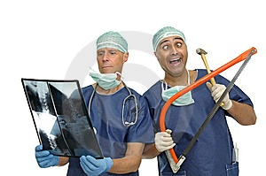
When MD’s Chart….
“On the 2nd day the knee was better and on the 3rd day it disappeared completely.“
"The patient has been depressed ever since she began seeing me in 1993."
"Discharge status: Alive but without permission."
"Healthy appearing decrepit 69 year-old male, mentally alert but forgetful."
"The patient refused an autopsy."
"The patient has no past history of suicides."
"Patient has left his white blood cells at another hospital."
"Patient had waffles for breakfast and anorexia for lunch.
"Patient has two teenage children but no other abnormalities."
"The patient was in his usual state of good health until his airplane ran out of gas and crashed."
"The patient will need disposition, and therefore we will find a doctor to dispose of him."

Slide 3
President Spencer W. Kimball
"We are concerned over the mounting number of divorces not only in our society, but in the Church.
We are just as concerned with those whose families and marriages seem to be held together in 'quiet desperation.‘
The Privilege of Holding the Priesthood," in Priesthood (Salt Lake City: Deseret Book Company, 1981), 4-5.

Slide 4
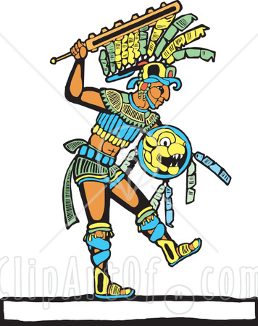
Amazing Lamanites
Alma 23
…yea, I say unto you, as the Lord liveth, as many of the Lamanites as believed in their preaching, and were converted unto the Lord, never did fall away.
For they became a righteous people; they did lay down the weapons of their rebellion, that they did not fight against God any more, neither against any of their brethren.
(Alma 24) And now it came to pass that when the king had made an end of these sayings, and all the people were assembled together,
they took their swords, and all the weapons which were used for the shedding of man's blood, and they did bury them up deep in the earth.

Slide 5
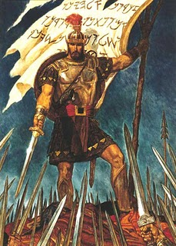
Swords
Different Uses
Offensive Weapon
Defensive only in that they keep others at a distance
Relationship Swords

Slide 6
Swords of Tradition
Alma 17
And it came to pass that [sons of Mosiah]…fasted much and prayed much that …they might be an instrument in the hands of God to bring…the Lamanites,
to the knowledge of the truth, to the knowledge of the baseness of the traditions of their fathers, which were not correct.

Slide 7
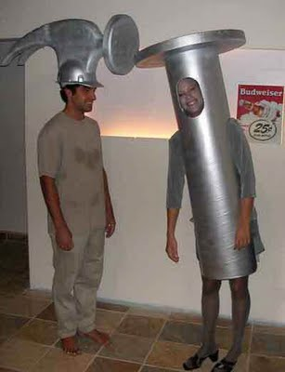
Question
Which traditions did you bring into the marriage?
Which ones can cause pain?
How is this sword affecting your relationship?

Slide 8
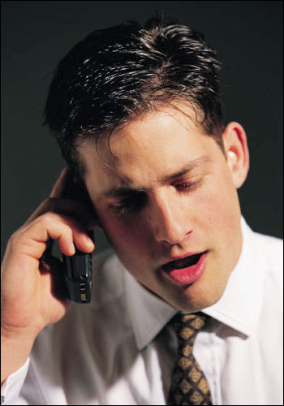
“Love Language” Sword
Love Languages
‘My Love Language is working hard and providing. I’ll never be good at listening to her.’
Question:
What are you doing to improve that?

Slide 9
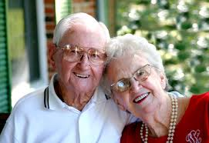
Swords of Expectation
What do you expect from your spouse?
What did you expect from marriage?
What about now?
What do you think your spouse expects from you?
Are those expectations 1)reasonable?
Have they been 2)expressed?

Slide 10
Relationship Expectations
Realistic
Unrealistic
Basic Wants and needs | Unattainable Wish List
Internal Belief System | Unexpected Emotional Reactions
Conscious
Unconscious
Kevinhinckleylpc.com

Slide 11
For instance, Sisters…
The male brain is not attuned to look for nuances in communication.
If there’s something you want, you must tell us-clearly!
Don’t’ hint.
Don’t craft ‘just the right response’ (you may have to do that for other women, but not for us).
Don’t hope that we’ll finally ‘get it’ without you saying anything. We won’t.
You have to tell us, often more than once, or we miss it!

Slide 12
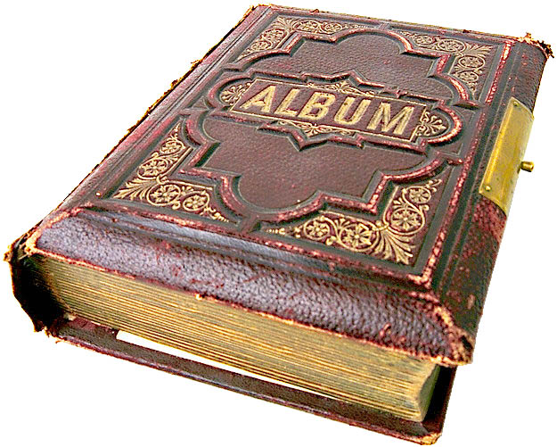
Sword of Goof Storage
Storing up memories of past goofs and stupids

Slide 13
Brace Yourself…
Elder Marion D. Hanks
"The withholding of love [holding a grudge] is the negation of the spirit of Christ, the proof that we never knew him, that for us he lived in vain.
It means that he suggested nothing in all our thoughts, that he inspired nothing in all our lives,
that we were not once near enough to him to be seized with the spell of his compassion for the world."
FORGIVENESS: THE ULTIMATE FORM OF LOVE

Slide 14
Elder F. Enzio Busche
In my humble understanding, it can be said that are only two elements that separate us from the Holy Spirit:
First, our lack of desire to repent
Second our lack of desire to forgive

Slide 15
Question
Do you possess the ability to remove old hurts and injustices from your brain?
Can you, by sheer will power, cause your brain to let go of deeply held grudges?
That, is precisely what the Atonement is for…

Slide 16
Remember, Ladies
Never attribute to malice
What is better explained by stupidity…

Slide 17
Sister from BYU Education Week
I was very anxious to return to my husband as I was filled was a increased love and appreciation for him after all I had experienced at Ed Week. I was looking forward to throwing myself in his arms and telling him how wonderful he was, how much I had missed him, and how much I had appreciated his staying home with our 4 daughters.
When I drove into my driveway I was greeted by my 4 and 6 year old daughters who ran gleefully up to the truck to give me hugs and tell me they missed me. It was the perfect greeting, just as I had imagined and anticipated. They were out there waiting for me because I had left a message 45 minutes before as to when I would be home. It was a sweet reunion, but I was still anxious to see my husband. Where was he? My six year old then informed me that Dad had just barely left to go golfing. I checked, and sure enough the golf cart was gone.
My female brain quickly went to work and in a matter of 3 or 4 seconds wondered why in the world he didn't wait to see me. Was he angry at me? Hadn't he missed me? Didn't he care? Was he resentful that I had been gone for 3 days and was he punishing me for leaving? ….
Then, I took a moment to reflect upon what I had learned at Ed Week. I took a moment to move away from my "perception" of his actions to give him the benefit of a doubt. I concluded simply that his “Husband Guy" was not out, but rather his "Golf Guy" was. So, instead of being a little hurt and put out by his timely departure for "greener pastures" I simply decided to do as you advised: I would not attribute to malice what is better explained by stupidity."

Slide 18
Swords of Silence (Men)
During times of distress and uncertainty you want serious cave time.
Keep it to a minimum.
Otherwise she’s guessing and she hates that more than you can know.

Slide 19
Sword of Stubborn
Brethren, Our natural man fights surrendering to the Lord. We fear we will be changed.
And we’re right.

Slide 20
Elder CS Lewis
To ask that God’s love should be content with us as we are is to ask that God should cease to be God; because He is what He is,
His love must, in the nature of things, be impeded and repelled by certain stains in our present character
And because He already loves us He must labor to make us lovable.
The Problem of Pain, p. 41

Slide 21
Sword of Stubborn
Brethren, Our natural man fights surrendering to the Lord. We fear we will be changed. And we’re right.
In the same way, men often complain, “She just wants to change me”. You’re right. She does. It is in her nature, as it is in God’s, to desire to change us.
And we do need changing. Our natural seflish selves need replacing.

Slide 22
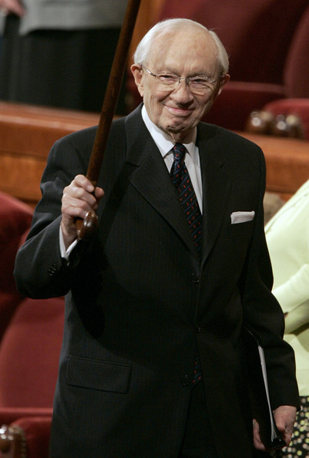
Finally, A Simple Hidden Marriage Secret?
President Hinckley
Following the benediction we shall depart this great hall, turn off the lights, and lock the doors. You who are listening across the world will switch off your television set or the radio or shut down the Internet.
I hope that we shall ponder with subdued feelings the talks to which we have listened. I hope that we will quietly reflect on the wonderful things we have heard. I hope that we will feel a little more contrite and humble….
Let us lower our voices in our homes. Let love abound and find expression in our actions. May we walk the quiet ways of the Lord, and may prosperity crown our labors. Nov Ensign, 2000

